Slide 1
A Pilot Phase Ib/II study of Whole-Lung Low Dose Radiation Therapy (LDRT) in the treatment of Severe Covid 19 Pneumonia patients on (or requiring) Mechanical Ventilatory Support.
Presented by : Dr Karishma Sharma
MBChB, MMed (Int Med).
Annual Early Career Health Researchers Symposium
Nairobi, Kenya
25th-26th November 2021

Slide 2
First Study in Africa at AKUHN
Investigators: Prof Mansoor Saleh: PI Director CRU/HOP Dr Karsan: Co-PI Radiation Oncologist Dr Martin Musumbi: Critical Care Specialist Dr Angela Waweru: Radiation Oncologist Prof Reena Shah: Head of Infectious dx Dr Jasmit Shah: Biostatistician Dr Karishma Sharma: Resident
Summary:
Phase Ib/II study
Location: AKUHN
2 Cohort: On-vent/Pre-Vent
Sample Size: 10 patients per cohort
DSMC oversight on all patients enrolled
Radiation dose: 100cGy
All patients signed informed consent.

Slide 3
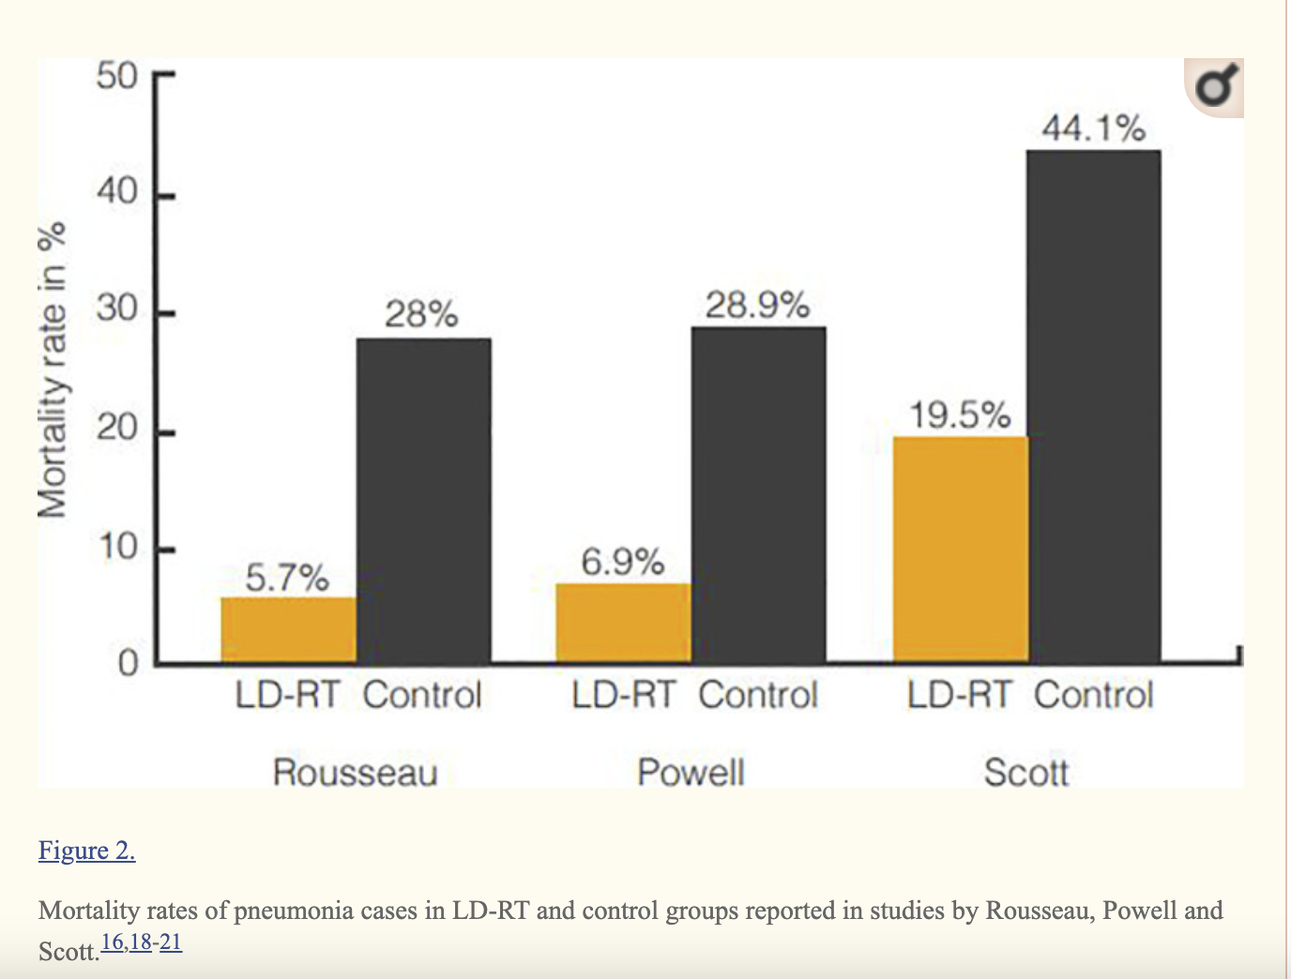
Background and Rationale
1898. Relief of pain in juvenile arthritis
Pandemic of 1917-1919, Spanish Flu
JP Rousseau et al 1942 – treatment of pneumonia with LDRT.
Oppenheimer et al – 56 presumed viral pneumonia cases. Complete clinical and radiological resolution within 3-5 days.
Low doses (<1 Gy) – anti inflammatory response - immunomodulation
RESCUE 1-19: First trial on LDRT in the world performed patients with Covid 19 found LRDT to be safe, feasible and reported a reduction in the intubation rates and time to discharge.

Slide 4
Objectives and Endpoints
Primary Objective
To assess the feasibility and safety of administered LDRT to patients with severe Covid 19 pneumonia
To assess the toxicity of a single dose of LDRT administered to patients with severe Covid 19 pneumonia
Secondary Objectives
Improvement in Oxygen requirement at 3 days following LDRT
Ability to come off or avoid mechanical ventilation within 7 days following LDRT
Discharge by 14d and 28d following LDRT
Death by 14d and 28d following LDRT

Slide 5
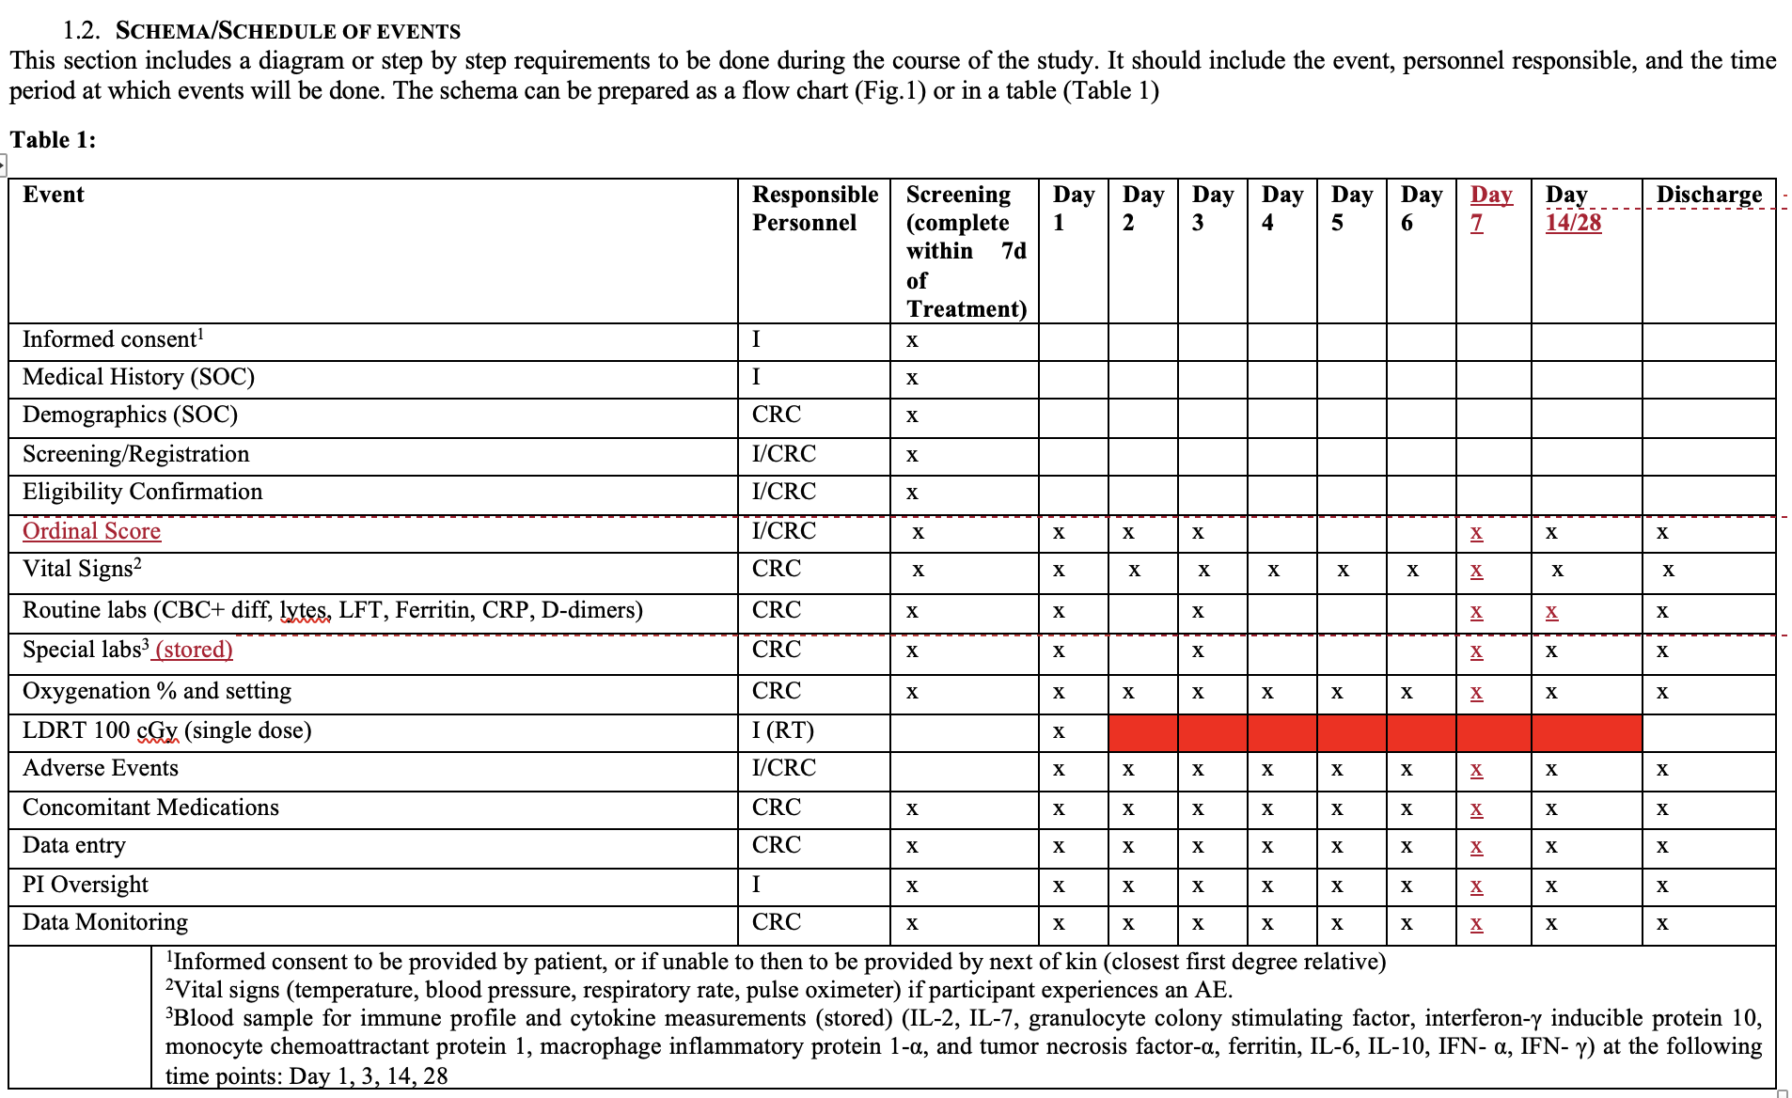
Eligibility Criteria
Confirmed covid 19 pneumonia
Requiring oxygen
Increasing oxygen requirements
Not improving on conventional therapy
Cohort 1 = Pre - Vent
Cohort 2 = On - Vent

Slide 6
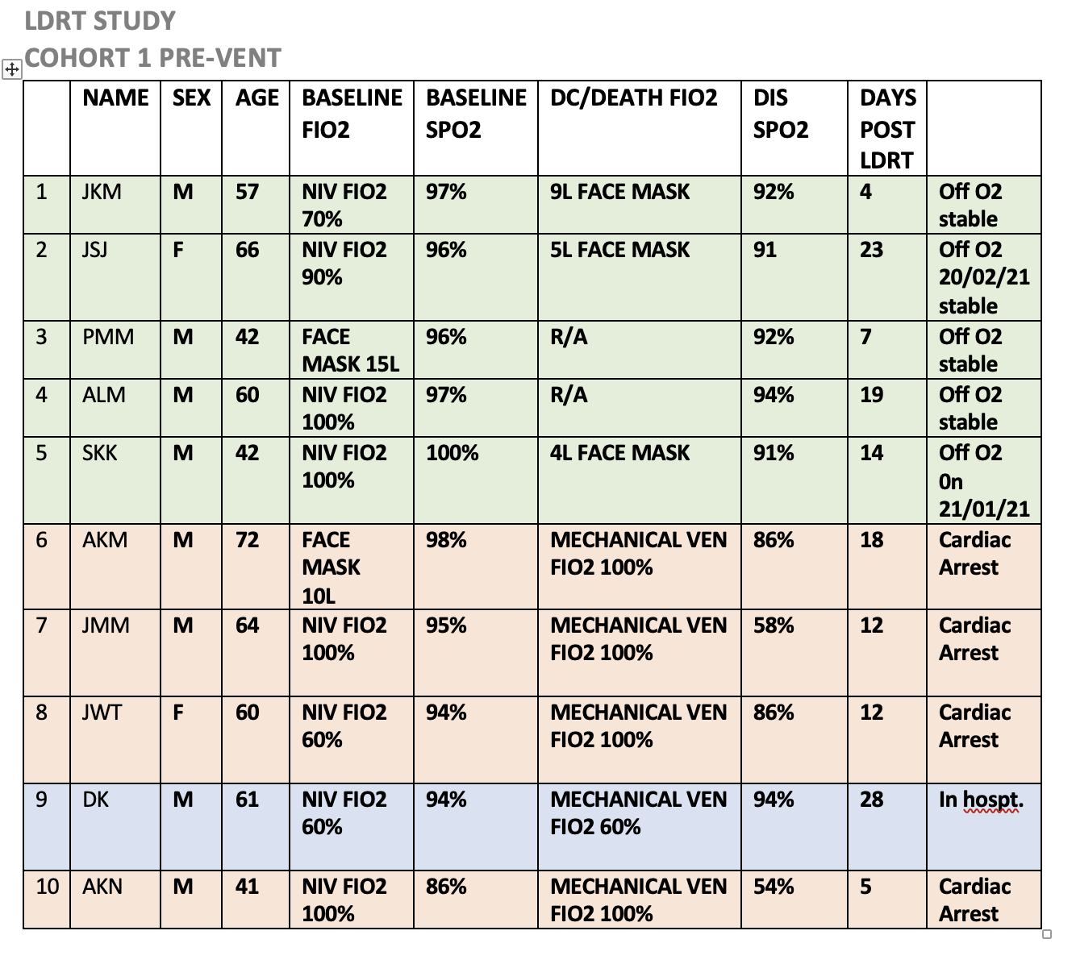
Enrollment
LDRT Total n=10
Pre-vent
n=10
Alive
n=6
Expired
n=4
On-Vent
n=0

Slide 7
Results

Slide 8
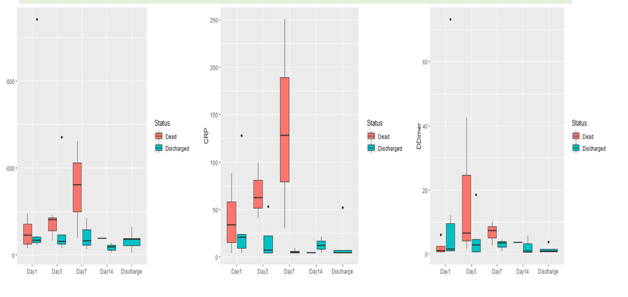
Inflammatory Markers

Slide 9
Endpoints
Primary
Safety/Feasibility: 10 (100%)
Toxicity: 0 ( 0%)
Secondary
Efficacy:
25% improvement in oxygen requirement within 3 day: 4 (40%)
Efficacy :
ability to avoid mechanical ventilation within 7 days following LDRT: 9 (90%)
Other Endpoints:
Time to discharge from LDRT: Median= 14 Days (4– 24)
Discharge at 14d (%): 3 (30%)
Death at 14d (%): 3 (30%)
Discharge at 28d (%): 5 (56%)
Death at 28d (%): 4 (44%)

Slide 10
Summary and Recommendation
Low dose radiation therapy is a safe and feasible option in the management of Severe COVID-19.
Need for phase 2/3 trials
Cost effective alternative to conventional therapies. $30 vs $3000
Further studies looking at utility of LDRT in early phases of Covid pneumonia.

Slide 11
THANK YOU

