Slide 1
Mental Health Clinical Stream
Output 2021
School of Nursing and Midwifery
Syeda Humera Qutb
Instructor,
The Aga Khan University School of Nursing and Midwifery
Karachi, Pakistan
Clinical Psychologist and Certified Hypnotherapist and Neurolinguistic Programming Practitioner(NGH, ABNLP, USA)
Ambreen Tharani
Assistant Professor,
The Aga Khan University School of Nursing and Midwifery
Karachi, Pakistan

Slide 2
Layout of the Presentation
About Stream
Teaching Innovation
Capacity building/outreach activities
Publications of 2020-21
(Intra and Extramural) Grants
Researches in Progress
Achievements
Way Forward

Slide 3
About Mental Health Stream
Mental health clinical stream at SONAM comprises of a group of faculty members and nurses working in the area of mental health. The purpose of this stream is to promote quality education, service and research in the domain of mental health nursing

Slide 4
Mental Health Clinical Stream Core Members
Ms. Ambreen Tharani - Assistant Professor (ambreen.tharani@aku.edu)
Ms. Syeda Humera Qutb- Instructor (syeda.humera@aku.edu)
Dr. Naghma Rizvi- Assistant Professor (naghma.rizvi@aku.edu)
Ms. Sharifa Lalani- Assistant Professor (sharifa.lalani@aku.edu)
Ms. Razia Momin- Clinical Preceptor (razia.momin@aku.edu)
Ms. Farida Bibi Mughal- Instructor (farida.bibi@aku.edu)
Ms. Shehla Khan- Assistant Professor (shehla.khan@aku.edu)
Ms. Shagufta Iqbal- Senior Instructor (iqbal.shagufta@aku.edu)
Ms. Nishat Tabassum-Assistant Professor (nishat.tabassum@aku.edu)
Ms. Zahra Tharani- Instructor (zahra.sultan@aku.edu)
Ms. Shireen Shehzad- Assistant Professor (shireen.shehzad@aku.edu)
Mr. Umair Ali- Clinical Preceptor & Taskeen NGO (umair.ali@aku.edu)
Ms. Sunita Allauddin, Head Nurse Psychiatry AKUH (sunita.allauddin@aku.edu)
Ms. Shafqat Shah, Nurse Manager, Service line Mind and Brain, AKUH (shafqat.shah@aku.edu)

Slide 5
Mental Health Clinical Stream Core Members
Members Away PhD /Sabbatical:
15. Ms. Salima Farooq- Senior Instructor (salima.farooq@aku.edu)
16. Ms. Lubna Ghazal. Assistant Professor (lubna.ghazal@aku.edu)
6 Nursing, 1 psychologist, 4 Non-Nursing, 1 CP
Mental Health Clinical Stream Associate Members
Mr. Shawkat Hussain, KEH
Ms. Yasirah Gohar (YG), /Uroosa Talib, KEH
*Ms. Mehwish (Aga Khan Health Board, Mental Health Portfolio)

Slide 6
Publications in 2021
Valliani, K., & Mughal, F. B. (2021). Human emotions during COVID-19: A lens through Kubler-Ross Grief theory. Psychological Trauma: Theory, Research, Practice, and Policy.
Khowaja, B. H., & Mughal, F. B., & Valliani, K. (2021). The Factors influencing utilization of C-section in Pakistan. Pakistan Journal of Medical Research, 61(2).
Zahid, N., Martins, R. S., Zahid, W., Khalid, W., Azam, I., Bhamani, S. S., ... & Enam, S. A. (2021). Resilience and its associated factors in brain tumor patients in Karachi, Pakistan: An analytical cross‐sectional study. Psycho‐Oncology, 30(6), 882-891.
Zahid, N., Zahid, W., Khalid, W., Azam, I., Ikram, M., Iftikar, H., Bhamani.,S.S ... & Ahmad, K. (2021). Resilience and its associated factors in head and neck cancer patients in Pakistan: an analytical cross-sectional study. BMC Cancer 21, 888
Zahid, N., Martins, R. S., Zahid, W., Khalid, W., Azam, I., Bhamani, S. S., ... & Enam, S. A. (2021). Translation and validation of the Urdu version of the European organization for research and treatment of cancer core quality of life questionnaire (EORTC QLQ-C30) and brain module (QLQ-BN20) in primary brain tumor patients. Journal of Patient-Reported Outcomes, 5(1), 1-12.
Gul, R. B., Tharani, A., Rizvi, N. F., Ali, S. K., Lakhani, A., & Gowani, A. (2021). Effect of formal training workshop on teachers’ quality of written feedback in higher education. Journal of Shifa Tameer-e-Millat University, 4(1), 16-24.

Slide 7
Publications in 2021
Tharani, A., van Hecke, A., Ali, T.S ., & Duprez, V,. (2021). Factors influencing nurses' provision of self-management support for patients with chronic illnesses: A systematic mixed studies review. International Journal of Nursing studies (accepted- in press) impact: 3.783
Tabassum,N.,HMA Khuwaja.,(2021). Retention of knowledge regarding mathematics and drug and dosages calculation among undergraduate nursing students of a private school of nursing in Pakistan, Journal of the Pakistan Medical Association JPMA,71(4)
Mughal, F. B., Rafiq, N., & Ali, B. H. I. (2020). Nursing Education amidst COVID-19: Obstacles and Way Forward. Pakistan Journal of Public Health, 10(4), 199-200.
Rafiq, N., & Mughal, F. B. (2020). Evolving nurse leadership role in 2020. Journal of the College of Physicians and Surgeons Pakistan, 30(12), 1243-1244.
Farooq, S., Lakhdir, M. P. A., Parpio, Y. N., Haider, S. I., Rahim, S., Nathwani, A. A., & Arthur, D. (2021). The effect of a culturally sensitive mental well-being module on Pakistani nursing students’ knowledge and beliefs regarding their own mental health and illness. International journal of mental health nursing.
Khan, S., & Iqbal, S. (2021). Innovative ways of student engagement for active learning in science 3 courses of nursing in the four year baccalaureate program. JPMA, 24, 25.

Slide 8
Publications in 2020
Farooq, S., Haider, S. I., Sachwani, S., & Parpio, Y. (2020). Insight into COVID-19 responses and initiatives from Pakistan. Journal of the College of Physicians and Surgeons--Pakistan: JCPSP, 30(6 (Supplement 1)), S50.
Farooq, S., Sachwani, S., Haider, S. I., Iqbal, S. A., Parpio, Y., & Saeed, H. Mental health challenges and psycho-social interventions amid COVID-19 pandemic: A call to action for Pakistan. Journal of the College of Physicians and Surgeons--Pakistan: JCPSP, 30(6 (Supplement 1)), S59.
Dosani, M., Farooq, S. M., & Ali, S. S. (2020). Maternal Health Challenges during COVID-19 and Way Forward. Journal of Asian Midwives (JAM), 7(1), 51-57.
Bhamani, S. S., Zahid, N., Zahid, W., Farooq, S., Sachwani, S., Chapman, M., & Asad, N. (2020). Association of depression and resilience with fertility quality of life among patients presenting to the infertility center for treatment in Karachi, Pakistan. BMC Public Health, 20(1), 1-11.
Tabassum, N., Nazar, A., Maqbool, H., Parpio, Y., & Shehzad, S. Class-Based Assignment: An innovative teaching strategy for Biostatistics course. Rejected in JPMA preparing for resubmission.
Mansoor, M., Najam, S., Nadeem, T., Allaudin, S., Moochhala, M., & Asad, N. (2020). Integrating mental health in COVID-19 crisis: Staff mental health referral pathway. Asian Journal of Psychiatry.
Bhamani,SS., Zahid,N., Rizvi A., Shaheen, F., Zahid NS., Sachwani ,S., Farooq S, Azam SI, Asad N., International Journal of Nursing Practice

Slide 9
(Few of the) Papers under review
Tharani, A., Farooq., S., Ali. M., Talib., U. & Khan., M.M. (2021). Characteristics of Individuals with Self-Harm: A Retrospective Descriptive Study from Karachi, Pakistan. Asian Journal of Psychiatry. (under review) impact 2.529
Saima, H., Tharani., A., Jetha, Z., & Khan, S. Insights from nursing students about factors affecting and strategies supporting their mental health. International Journal of Mental Health Nursing (under review) impact: 3.503
Dr Naghma and Ms. Shehla Khan. Academic Background as a Predicator of Performance in Science Subjects amongst Undergraduate Nursing Students Enrolled at a Private University in Pakistan
Shams, S., Jan, R., Jabbar, A., Nanji, K., & Tharani, A. Impact of Supportive Care on Chemotherapy Women Physical and Affective Symptoms. Palliative & Supportive Care. Impact: 2.257
Tharani, A., Khan, S., Jetha, Z., & Hirani, S. What is mental health to me? Views from Students, Educators and Staff Members of Private Nursing School. Nurse Education in Practice (rejected- preparing for resubmission) impact 1.614

Slide 10
Publication Journals
Journal Name | Impact Factor
International Journal of Nursing Studies | 3.783
Asian Journal of Psychiatry | 1.82
Journal of Asian Midwives | 1.778
Journal of Nursing Education | 1.614
International journal of mental health nursing. | 0.911
i.manager's Journal on Nursing | 0.897
Pakistan Journal of Public Health | 0.754
Journal of the College of Physicians and Surgeons Pakistan | 0.453

Slide 11
Active Grants-Extramural
Investigator(PI) and team members | Title of the grant | Department | Name of sponsor | US $ value received by AKU
PI: Dr Rozina Karmaliani Co-PI: Farida Bibi Mughal, Shireen Shehzad, Dr Nargis Asad, Dr Tania Nadeem, Dr Saima Hirani, Dr Rosemin | Title of project: Short- and long-term impact of COVID-19 on mental health and wellbeing of health workers in Pakistan | AKU SONAM | Granting Agency: Canadian Institute of Health Research (CIHR) | 302,175
PI: Dr Rozina Karmaliani SONAM Team: Khairulnissa Ajani, Rubina Barolia, Ambreen Tharani, Arusa Lakhani Syeda Humera, Nimira Asif DR. Nargis Asad, Dr. Zul Mehr | Foundations for Health & Empowerment | Multi country grant to AKF, P Lead for Pakistan AKU-SONAM | AKF Canada | CAD $548000
PI: Yasmin Parpio Team Members: Naghma Rizvi, Shehla Khan, Shagufta Iqbal & Sehrish Sajjad | PGME Female Enrichment Program for Intake 2021 | AKU SONAM | Health Action Plan For Afghanistan | 20,176

Slide 12
Active Grants-Extramural
Investigator(PI) and team members | Title of the grant | Department | Name of sponsor | US $ value received by AKU
PI: Zulekha Saleem CoPI: Zohra Jetha, Khairunnisa Mansoor, Ambreen Tharani, Sharifa Lalani, Farida Mughal, Syeda Humera Qutb and Zahra Tharani | Capacity building training plan of LHVs and midwives - AKHSP (Sindh) | AKUSONAM | Aga Khan Health Services for Pakistan | 9,207
PI: Dr. Rafat Team Members: Kiran Mubeen, Zulekha Saleem, Dr. Rozina Karmaliani, Rozina Roshan & Shagufta Iqbal etal. | Empowering Health Professionals to Combat COVID 19 through Virtual Continuing Professional Education Approach | AKU SONAM | EU Civil Prot.& Humanitarian Aid Ops | 16403.24
Sharifa Lalani, Kiran Shaikh, Dr. Shairose Premji | Impacts of Prenatal Stress and Preterm birth on Infant Health and Development and Maternal-Child Relationships: Feasibility Follow-Up Study | AKU SONAM | CIHR | Budget from previous study is being used

Slide 13
Active Grants-Intramural
Investigator(PI) and team members | Title of the grant | Department | Name of sponsor | Grant value
PI: Dr. Laila Ladak CoPI: Ambreen Tharani, Rozina Roshan, Lubna Ghazal, Sajida Chagani, & Umair Bachlani | Fear and Stigma related to COVID-19 in patients and their health care providers and its impact on their health seeking behavior: a mixed method study | AKUSONAM | Seed grant | PKR: 631,000

Slide 14
Extramural grants submitted
Investigator(PI) and team members . | Title of the grant | Department | Name of sponsor | Date of submission
PI: Sharifa Lalani Kiran Sheikh, Dr. Shairose Premji | Impact of maternal prenatal distress on child development and health: role of allostatic load and parent-child interaction quality | AKU SONAM | Canadian Institute of Health Research | 03-03-2020 (approval pending)
UCL Co-PI: Drs. Sajid Soofi & Rozina Karmaliani (SONAM and CoE) Team: Ambreen Tharani, Atif Habib Partners: ACF | The mental health system of Maternal & Child Health among the Migrants, Climate resilient Multi-country grant | AKU- COE and SONAM | NIHR (submission in process) | 2021 approval pending
PI: Dr Salma Rattani Team: Farida Mughal, Zohra, Mehtab, Sadia, Nasreen, Saima, Shirin, Zulekha | Developing integrated contextual based virtual reality simulation scenarios to strengthen clinical practice of nursing students in LMIC | AKU SONAM | Grand Challenge Fund-HEC | 2021 Approval pending
Shagufta Iqbal & Nishat Tabassum. Dr. Tazeen Saeed Ali and Zulekha Saleem | Factors associated with COVID 19 severity among Pakistani individuals Mixed method approach | AKU SONAM | ELrha -Humaintarian innovation fund Grant | Rejected

Slide 15
Researches in Progress
Title | Name of PI and team members | Status | Budget
Provision of self-management support by nurses in care of patients with chronic illness | Ambreen Tharani, Dr. Ann Van Hecke, Dr. Veerle Duprez, Dr. Tazeen Ali | Data collection in progress | FDA
Open Book exams: An Unprecedented Challenge for Faculty in Nursing Education | Dr Naghma, Ms Ambreen Tharani Ms Farida Mughal and Ms Zohra Jetha | Data collection is completed and data analysis in progress | Stream budget
Fear and Stigma related to COVID-19 in patients and their health care providers and its impact on their health seeking behavior: a mixed method study | Dr. Laila Ladak, Ambreen Tharani, Rozina Roshan, Lubna Ghazal, Parveen Chagani, & Umair Bachlani | Data collection in progress. | Seed grant
Impacts of Prenatal Stress and Preterm birth on Infant Health and Development and Maternal-Child Relationships: Feasibility Follow-Up Study | Sharifa Lalani and Kiran Shaikh | Data collection in progress | CIHR
Prevalence of Cesarean Section in a Tertiary Care Hospital: A Cross-sectional Study | Farida Bibi Mughal, Bakhtawar M.Hanif Khowaja and Komal Jiwani | Data collection in progress | No budget

Slide 16
MScN Thesis
Stream members are contributing as committee members on thesis
Budgetary support for MScN thesis “Prevalence and factors associated with anxiety and depressive symptoms among undergraduate nursing students of Khyber Pakhtunkhwa, Pakistan. [Muhammad Ilyas; Supervisor: Ms Yasmeen Parpio]

Slide 17
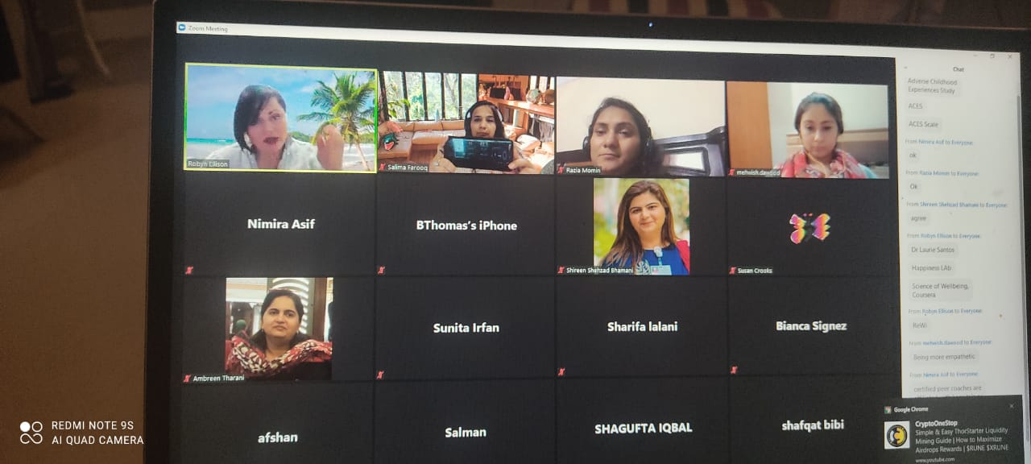
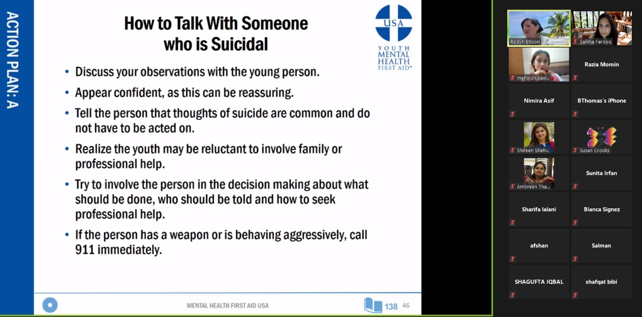
Workshops/Conferences/Seminars attended
Eleven stream members completed Youth Mental Health First Aid Provider Training in collaboration with Walt’s Waltz (USA based) are June 29th (Day 1) and July 7th (Day 2).
NIH Grant Writing | 23rd National Health Sciences Research Symposium | COVID-19: Challenges & Way Forward- February 24, 2021-Ms. Ambreen Tharani
Psychological impact of covid-19 on masses- A Webinar organized by Psychiatry ward in collaboration with SONAM- April, 2020. Ms. Sharifa Lalani and Ms. Nimira Asif
SRF Research Series | SPSS: the software for robust quantitative data analysis - August 25, 2021. Shireen Shehzad

Slide 18
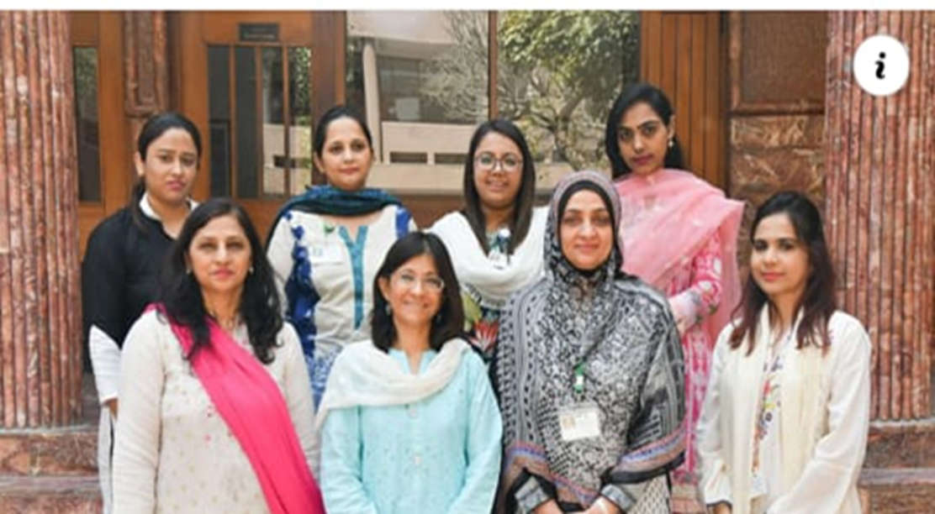
Achievement:
Received 4th best poster award
Ms. Shehla Khan, Ms. Shagufta Iqbal. Fourth educational research day 2020 Title: Innovative ways of student engagement for active learning in science courses of nursing in the Four Baccalaureate program.
Collaborative researches to Cherish

Slide 19
WAY FORWARD
To promote intra-/inter-disciplinary collaboration with in-house, local, national and regional organizations for promoting research, education, capacity building and clinical practice.
  Exemplars:
  Brain and Mind Institute, AKU
  Walt's Waltz (USA)
  Self-Empowerment Center, Pakistan
  Karwan-e-Hayat and Taskeen Foundation
  Aga Khan Health Service, health board
  Exploring more [Kazim Trust; Transformation International society]

Slide 20
WAY FORWARD
Promoting working in ‘themes for team’ (implemented)
Innovation in (theory and practical) teaching to enhance students’ and Trainee Nurse Interns (TNI) experience
Under BMI initiation: Masters’ of Mental health Nursing Track across AKU campuses
Activities for mental health promotion and liaison among students and faculty. Messages
Leading/contributing to collaborative researches and grants (exemplar: F4HE, ECHO, )
Capacity building workshops from/for stream members
World Mental health day 2021: Mental Health in an Unequal World

Slide 21
Way Forward
Nurturing Leaders
  SONAM Research lead representation: Humera and Farida
  Webpage: *Shagufta, Shehla and Zahra
  Collaboration and expending scope of stream function: *Humera and Ambreen
  Teaching and Learning Innovation: *Farida, *Dr. Naghma and Sharifa
  Promoting stream research output: *Dr. Naghma, Ambreen, Farida, Sharifa
  Central data base for stream: Faraz, *Farida, Faraz, Shagufta
  Student Mental Health Society: *Humera, Nishat, Razia, and Zahra
  *Lead person

Slide 22
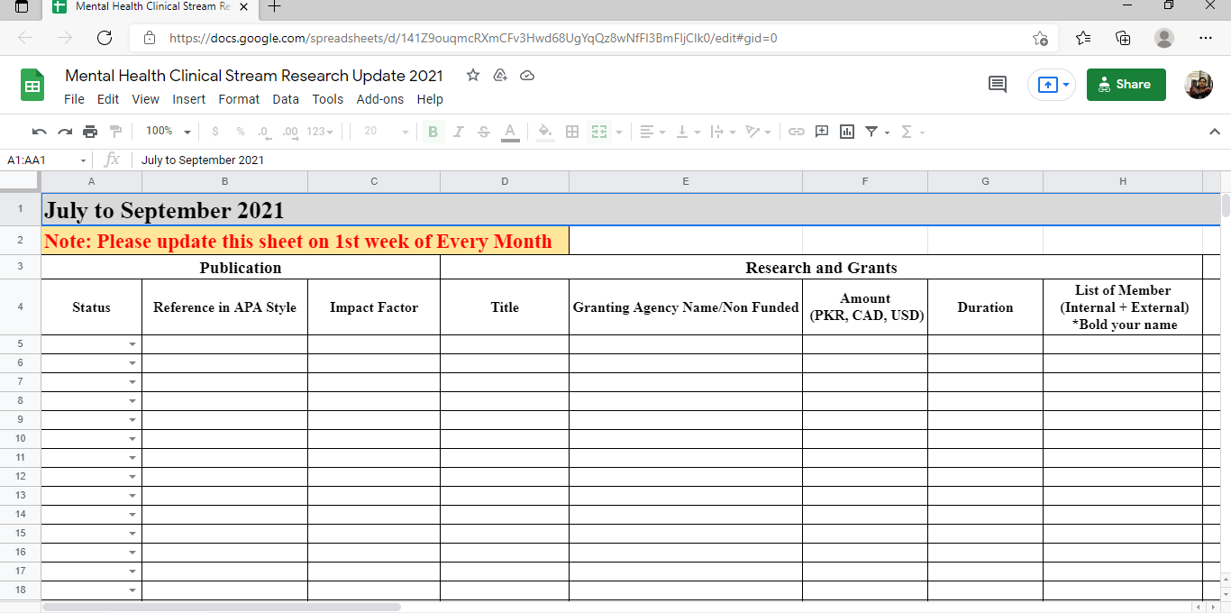
Central Data of stream activities/achievement

Slide 23
Thank You!
School of Nursing and Midwifery

