Slide 1
DECISION-TO-DELIVERY INTERVAL OF EMERGENCY CAESEREAN SECTIONS AND THE ASSOCIATED MATERNAL AND NEONATAL OUTCOMES AT THIKA LEVEL 5 HOSPITAL, KIAMBU COUNTY. Authors: Machoka P.K., Mburugu P.M., Ndungu S.K., Wangari L., Kamau L.W., Luchemo P., Simba J. M., Michieka N., Thuo R., Makworo D., Lusweti B.M. Affiliation: Jomo Kenyatta University of Agriculture and Technology, Thika Level V Hospital, Health-Professionals Education Partnership Initiative (HEPI)
You may add your institutions logo

Slide 2
Background information
Decision-to-delivery interval (DDI) refers to the duration between the time a decision to perform an emergency caesarean section is made to the time the neonate is delivered.
American College of Obstetricians and Gynaecologist and the National Institute for Clinical Excellence suggests that the DDI should not exceed 30 minutes in EMCS and not more than 75 in the event of maternal and/or foetal compromise since this can result in poor outcome.

Slide 3
RESEARCH OBJECTIVES
To determine the DDl of the emergency caesarean and the associated maternal and neonatal outcomes at Thika level V hospital.

Slide 4
STUDY METHODOLOGY
Site: Thika Level V hospital
Design: Ambidirectional study
Population: Four hundred and nineteen mothers who underwent EMCS and their newborns
Data Collection: Retrospective data was abstracted from the health records department for the months of June to August, 2019
Prospective data was collected from the obstetric wards, maternity theatre and the new-born unit within the period of 30th September to 4th October, 2019 to validate the data.
Sample size: 419 mothers

Slide 5
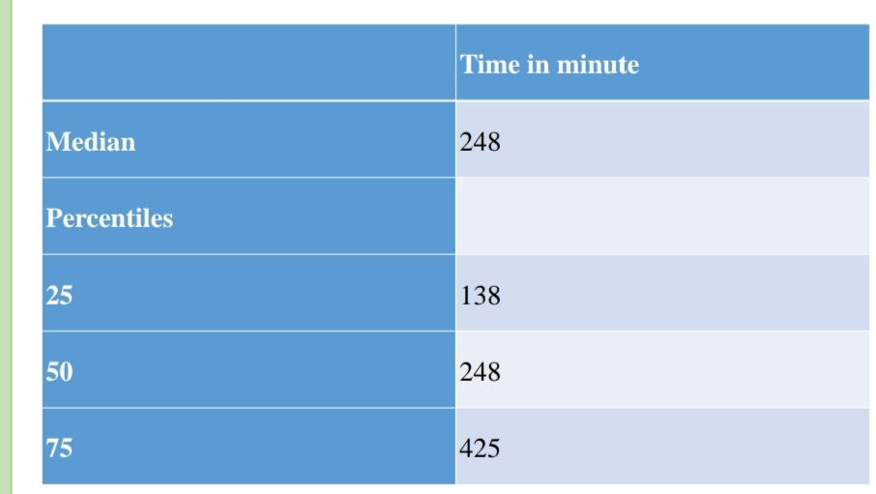
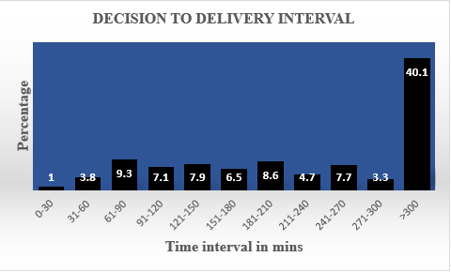
RESULTS
Median and percentiles of DDI
Distribution of DDI in minutes
The median DDI was 248 minutes
Only 1% of the study sample had the recommended DDI of ≤30 minutes. 8.4% had a DDI ≤ 75minutes while the rest (91.6) had a DDI exceeding 75 minutes.

Slide 6
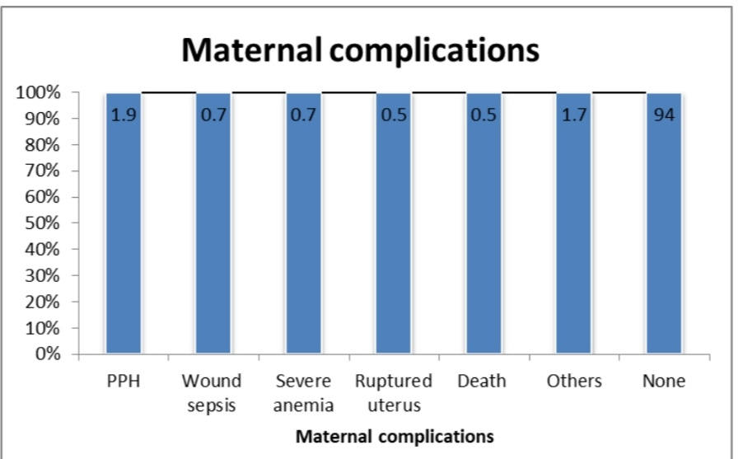
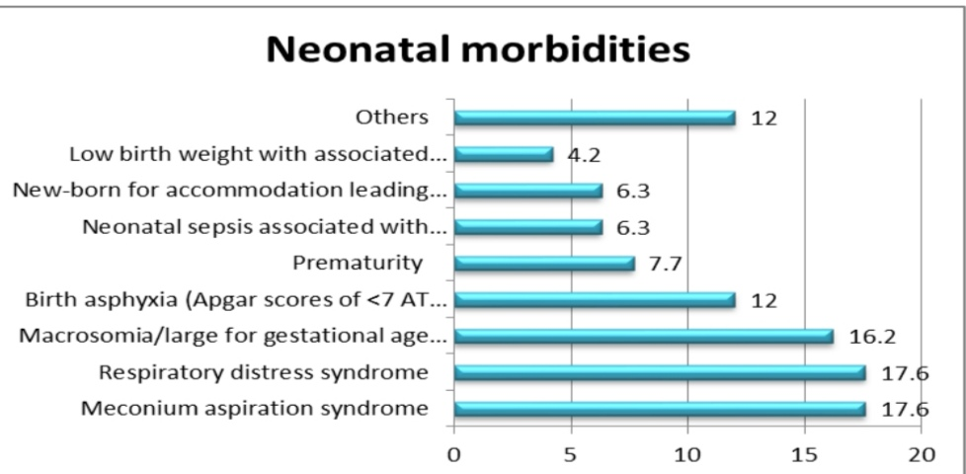
RESULTS
Maternal Complications
Neonatal complications
Six percent of the mothers developed complications. There was no significant association between DDI and maternal complications.
Of the NBU admissions, MAS and RDS accounted for 17.6%, each and birth asphyxia 12.0%. Perinatal deaths recorded were 1.4%, fresh and macerated still births were 2.6% and 1%, respectively. There was a significance association between prolonged DDI and neonatal outcome (p=0.024)

Slide 7
Conclusion
Contrary to DDI recommended by ACOG & AAP of 30 minutes, TL5H were unable to meet this target. The result of the study shows that only 1% of the DDI is within 30 minutes and 8.4% within the 75 minutes.
The median DDI for this study was 248 minutes. This was comparable to a study conducted by Habib et al in which the median DDI was 178 and 290 minutes at KNH and PMH, respectively.
DDI at TL5H was longer than the recommended. There was no significant association between the DDI and the maternal complications and prolonged duration of hospital stay.
Prolonged DDI significantly influenced the neonatal outcome.

Slide 8
RECOMMENDATIONS
A short interval of DDI is paramount for optimal maternal and neonatal outcomes to be achieved in the clinical practice.
Hospital management:
To increase infrastructure in the facility in order to decongest the demand for theatre.
To come up with guidelines for estimation of the urgency of EMCS so that DDI is individualized based on the indication.

Slide 9
Acknowledgment
Audience
Supervisors
HEPI
JKUAT
AKU
Thika Level 5 Hospital

