Slide 1

A comparative evaluation of ADAGIO and VITEK Antimicrobial Susceptibility Testing Platforms
Justin Nyasinga, Njenga John, Mohammed Munshi & Gunturu Revathi
5th Annual Early-Career Health Researchers’ Symposium
26th November, 2021

Slide 2
Antimicrobial resistance (AMR)
WHO-recognized threat to global health
~ 700,000 deaths annually
~ 100 Billion USD in additional costs
~ 10 million deaths annually by 2050

Slide 3
Diagnostic microbiology
Reliable, rapid and cost-effective antimicrobial susceptibility testing (AST) >>
    Swift transition from ET to DT
    Saves money
    Saves time
    Diagnostic stewardship
    Antibiotic stewardship
Access to these services a challenge in LMICs

Slide 4
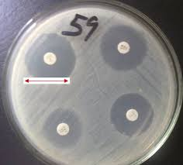
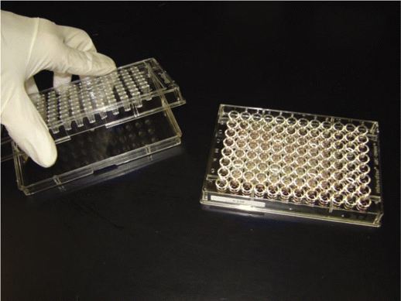
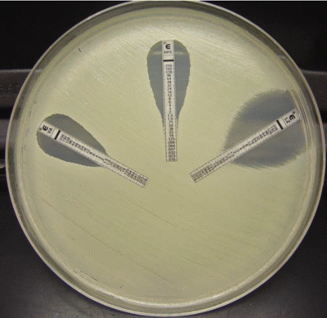
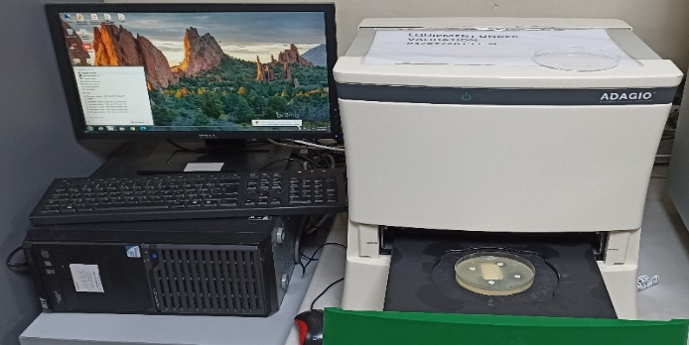
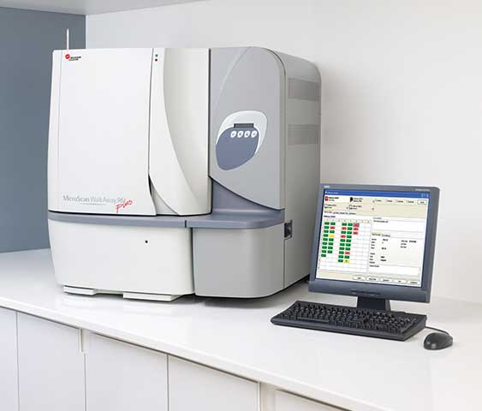
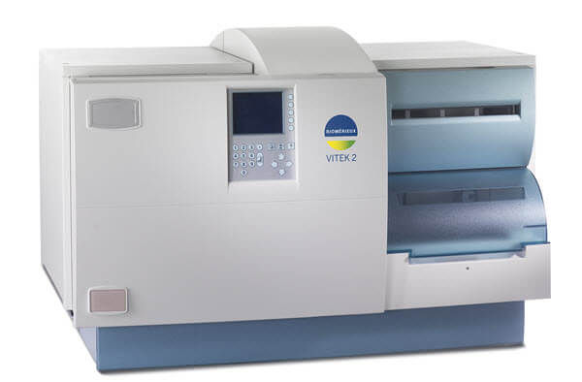
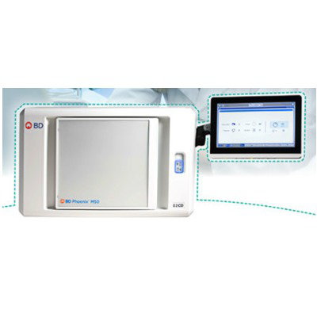
  1st Generation AST methods - Manual
Kirby-Bauer
Microdilution
E-test strips
  2nd Generation AST methods - Semi-automated
ADAGIO platform
ADAGIO output
  3rd Generation AST methods - Automated
Microscan
VITEK
Phoenix

Slide 5
Question
What is the performance of ADAGIO AST (semi-automated) in comparison to VITEK AST (automated)?

Slide 6
Methods
N=202 (Urine, Blood, Stool, Wounds)
AST interpretation: CLSI 2019 guidelines, verified by a clinical pathologist

Slide 7
Categorical agreements
Categorical agreement: When two methods corresponded in assigning a phenotype (Resistant, Intermediate, Susceptible)
Categorical disagreements:
Major discrepancy: When there was a Resistant/ Susceptible conflict
Minor discrepancy: When there was a Intermediate/Susceptible or Intermediate/Resistant conflict
A total of 1, 568 drugs (784 drug pair comparisons) were tested
Categorical agreements averaged 92%, ranged between 75% - 100%
None of the methods was used as the gold standard

Slide 8
Inter-rater reliability
Cohen’s Kappa scores (inter-rator reliability) were computed as:
κ=Pr(a)−Pr(e)
1−Pr(e)
Kappa scores for inter-rator agreements: 0.503 (Moderate) - 1.000 (Perfect)

Slide 9
Reagent and consumable cost comparisons
STEP | ADAGIO |  | VITEK
 | Unit cost (USD) | Total cost (USD) | Unit cost (USD) | Total cost (USD)
Culture and identification | The cost is the same for both methods
Vitek GP/GN cards | - | - | 7.5 | 7.5
Mueller Hinton agar | 0.5 | 1 | - | -
90 mm Petri plates | 0.06 | 0.12 | - | -
AST discs * | 0.15 | 1.80 | - | -
Total cost per isolate | 2.92 |  | 7.5
There was a 61% reduction in costs for ADAGIO compared to VITEK

Slide 10
Conclusions and future outlook
High levels of categorical agreement between ADAGIO and VITEK
Significant reduction in reagent and consumable costs per isolate in ADAGIO
Better technologies for AST will come
What is more relevant in the LMIC setting?

Slide 11
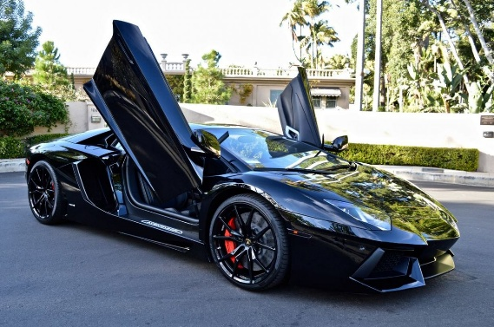
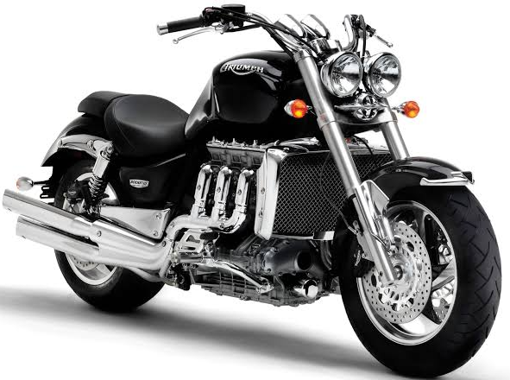


VITEK-MS
Kirby-Bauer

Slide 12
Thank you

