Slide 1
PLANNED DELIVERY AT 37 WEEKS GESTATION VERSUS EXPECTANT MANAGEMENT FOR NON-SEVERE CHRONIC HYPERTENSION, A SYSTEMATIC REVIEW
Presenter: Jackson Njuguna
PGY 4, Department of Obstetrics & Gynecology
Supervisors: Dr. Sikolia Wanyonyi, Dr. Angela Koech, Dr. Geoffrey Omuse
26/11/2021

Slide 2
Background and Objective
Incidence of chronic of hypertension in pregnancy increasing (rising rates of obesity and delayed age at conception).
Chronic hypertensive disease is independently associated with an increased incidence of adverse maternal and perinatal outcomes.
Optimal timing of delivery for women with this condition has not been adequately addressed by available literature.
We aimed to assess the benefits and risks of a policy of planned delivery versus expectant management in pregnant women with non-severe chronic hypertension at 37 weeks gestation.
Notes:
-Delayed delivery carries maternal risks, while early delivery increases fetal risk, so appropriate timing is important. The optimal timing of delivery for women with this condition has not been adequately addressed by available literature.
-For chronic hypertension in pregnancy, high level evidence to guide the appropriate timing of delivery is lacking and the available evidence is conflicting
-Objective: To review the literature that assesses the benefits and risks of a policy of planned delivery versus expectant management in pregnant women with non-severe chronic hypertension at 37 weeks gestation

Slide 3
Research Design & Outcomes
A systematic review and a narrative synthesis as we did not find enough studies for a meta-analysis.
Study types eligible - RCTS & cohort studies comparing the two policies.
Participants - women with non-severe chronic hypertension from 37+0 to 42+0 weeks of gestation.
Non-severe chronic hypertension- BP >140/90mmHg, < 160/110mmHg at recruitment or prior to 20 weeks gestation.
The intervention we studied was timing of delivery.
Notes:
-While delayed delivery increases maternal risks, early delivery is associated with increased risks to the fetus and optimal timing is important.
-From the available literature, there are numerous studies done on chronic hypertension in pregnancy. The studies however, are of different study designs, looking at patients in different settings and also giving different results. There is no systematic review addressing the timing of delivery in women with non-severe chronic hypertension. For this reason, we conducted a systematic review to investigate the optimal timing in women with this condition

Slide 4
Outcomes
Primary outcomes
Composite maternal outcome (including pre-eclampsia, placental abruption, admission to ICU)
Composite perinatal outcome (including stillbirth, NICU admission)
Secondary outcomes
Maternal-pre-eclampsia, placental abruption and admission to ICU.
Perinatal-stillbirth and admission to NICU)

Slide 5
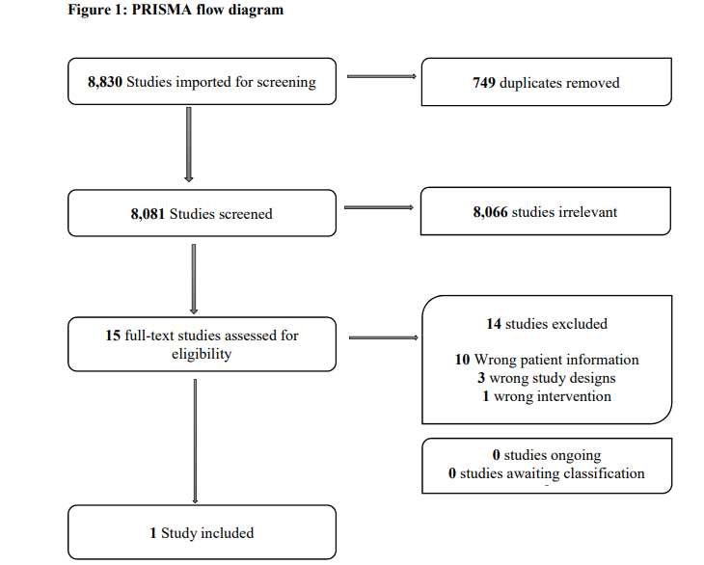
Notes:
-We pooled all articles identified by electronic searches together and removed duplicates by matching author names and study titles. We resolved any disagreements arising from the title and abstract screening via consensus between the involved review authors.
-Full text reviews were also done by two independent review authors. This was done for articles deemed eligible for selection and those requiring further interrogation to determine eligibility. Disagreements were resolved by consensus. We used the Covidence web application software approved by the Cochrane Collaboration (16) to facilitate the review steps. We displayed the process of study selection in a flow diagram and did a detailed descriptive analysis

Slide 6
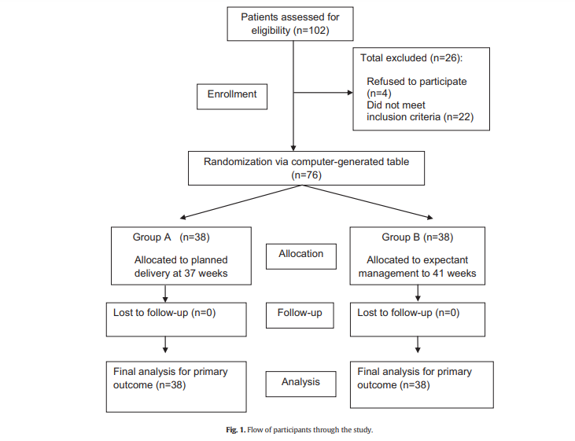
Characteristics of included study
Notes:
-2 arm 2 center RCT conducted between April 1, 2012 and October 31, 2013. Carried out at Maternity-Children Hospital, Al-Qassim region, Saudi Arabia and Women’s Health Center, Assiut University, Egypt.
The sample size calculated to detect any statistical difference between the two groups in the development of SPE.
A total of 74 participants would be needed to demonstrate this difference with 80% power and a type 1 error probability of 5%
-The authors calculated a sample size based aiming to detect any statistical difference in the development of superimposed pre-eclampsia between the two groups. The assumed risk of superimposed pre-eclampsia from the mid trimester of pregnancy was 20%–40% (mean, 30%). They hypothesized that planned delivery at 37 weeks might result in a 30%–50% reduction in this risk with considerable clinical significance. Seventy four study participants would be required to demonstrate this difference with 80% power and a type 1 error probability of 5%.

Slide 7
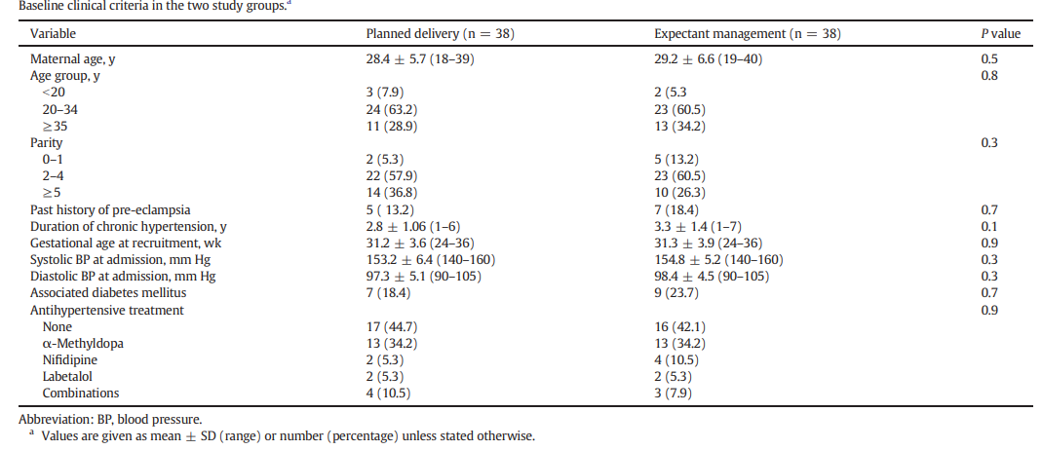
Participants
Notes:
-The authors did not indicate the racial distribution of the participants or smoking or other substance use status. From the information available, there were no significant differences in the baseline characteristics between the two groups
-Inclusion criteria
singleton pregnancy
mild to moderate essential chronic HTN.
No proteinuria
24 to 36 weeks gestation at recruitment.
Exclusion Criteria
Severe chronic HTN
Gestational HTN
New onset pre-eclampsia
Secondary HTN
Target organ damage
Medical/obstetric risk factors

Slide 8
Intervention
Experimental intervention group - delivery at 37 completed weeks. Oxytocin infusion and amniotomy or cervical ripening based on Bishop score.
Comparator intervention group- expectant management until the spontaneous onset of labour or 41 gestational weeks. Inpatient monitoring.
Notes:
For the experimental intervention group delivery was conducted at 37 completed weeks, if there were no maternal or fetal complications that would have necessitated preterm delivery. Cervical assessment was done to determine the approach to induction of labor. Oxytocin infusion and amniotomy were used if the Bishop’s score was > 8, while vaginal misoprostol at a dose of 50 µg every 6 hours up to a maximum of 200 µg, was used if the Bishop’s score was 8 and below. This was followed by oxytocin infusion and amniotomy. For women who were already on antihypertensive medication before recruitment, this was continued and with appropriate monitoring of the dose to achieve optimal blood pressure control.
In the comparator intervention group, participants were managed expectantly until labor set in spontaneously or up to 41 gestational weeks, whichever came earlier. Monitoring was done on an outpatient basis. This involved measurement of blood pressure and proteinuria screening 2 to 3 times in a week. They were admitted for the initial evaluation and if any fetal or maternal complications occurred. For women who were already on antihypertensive medication before recruitment, this was continued and with appropriate monitoring of the dose to achieve optimal blood pressure control.

Slide 9
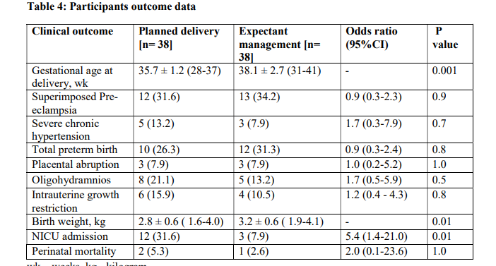
Notes:
-Outcomes of interest, SPE, placental abruption, NICU admission.

Slide 10
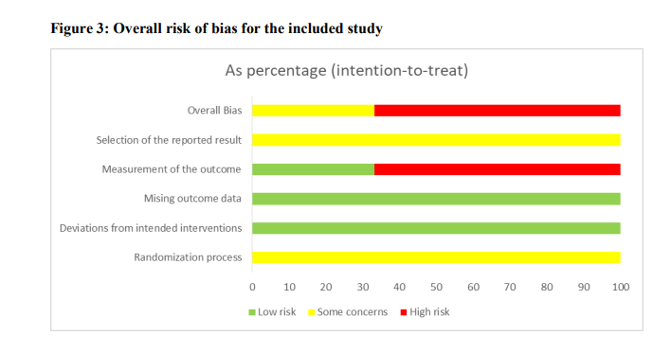
Notes:
-Using the Cochrane RoB Tool version 2
-Randomization Process-For sequence generation, the study randomized participants based on a computer generated table that assigned them to the two interventions at a ratio of 1:1. The overall judgement for the risk of bias in this domain was low. This was the same for all the outcomes. There was no information on whether allocation concealment was done in this study for all the three outcomes. It is possible that lack of allocation concealment might have had an effect on treatment decisions. As such, the overall judgement for all the outcomes was ‘some concerns’
Deviations from intended interventions
-Blinding of participants and personnel for all the three outcomes was not done in the included studies and this applied to all the three outcomes.
On blinding outcome assessors for all outcomes, the study authors did not give information on whether this was done. This may have affected treatment or assessment decisions especially for super-imposed pre-eclampsia and placental abruption. Regarding admission to NICU, it is also not clear whether outcome assessors were blinded but it was unlikely that this would have affected treatment or assessment outcomes.
Overall, we considered the risk of bias to be ‘high’ for superimposed pre-eclampsia and ‘some concerns’ for admission to NICU.
Missing outcome data
-All participants recruited to the study were followed up to completion of the study and no attrition was reported. Data on all the study outcomes was available for all the participants as initially assigned to the two interventions. The participants were also analyzed based on intention to treat basis.
The risk of bias in this domain was low for all the three outcomes
Measurement of the outcome
The authors described the method used to assess for super-imposed pre-eclampsia based on laboratory investigations (proteinuria or thrombocytopenia). There was no information on how placental abruption was assessed and the criteria for admission to NICU was not indicated.
It is likely that patients in the experimental intervention group who were admitted for delivery, had closer monitoring compared to the expectant management group that was monitored as outpatients. This might have affected outcome assessment with the likelihood of favoring more events in the experimental group. For admission to NICU, though the criteria for admission was not indicated, it was unlikely to affect to affect the overall result.
Overall, we found the risk of bias in this domain to be ‘high’ for the outcomes of super-imposed pre-eclampsia and ‘low’ for admission to NICU
Selective reporting
The study authors did not make any reference to a study of protocol or trial registration. For this reason it was not possible to ascertain whether all pre-specified outcomes were assessed or not.
As a result, we ranked the overall risk of bias in this domain as ‘some concerns’ for all the outcomes.

Slide 11
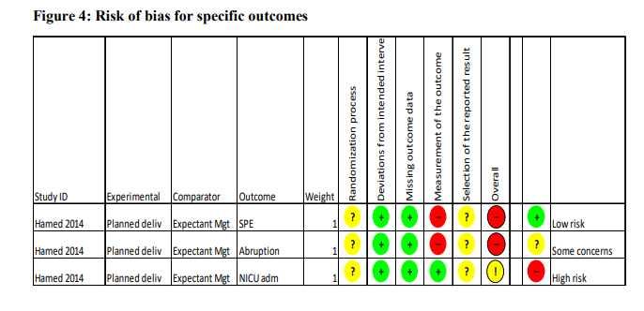
Notes:
Randomization Process-For sequence generation, the study randomized participants based on a computer generated table that assigned them to the two interventions at a ratio of 1:1. The overall judgement for the risk of bias in this domain was low. This was the same for all the outcomes. There was no information on whether allocation concealment was done in this study for all the three outcomes. It is possible that lack of allocation concealment might have had an effect on treatment decisions. As such, the overall judgement for all the outcomes was ‘some concerns’
Deviations from intended interventions
-Blinding of participants and personnel for all the three outcomes was not done in the included studies and this applied to all the three outcomes.
On blinding outcome assessors for all outcomes, the study authors did not give information on whether this was done. This may have affected treatment or assessment decisions especially for super-imposed pre-eclampsia and placental abruption. Regarding admission to NICU, it is also not clear whether outcome assessors were blinded but it was unlikely that this would have affected treatment or assessment outcomes.
Overall, we considered the risk of bias to be ‘high’ for superimposed pre-eclampsia and ‘some concerns’ for admission to NICU.
Missing outcome data
-All participants recruited to the study were followed up to completion of the study and no attrition was reported. Data on all the study outcomes was available for all the participants as initially assigned to the two interventions. The participants were also analyzed based on intention to treat basis.
The risk of bias in this domain was low for all the three outcomes
Measurement of the outcome
The authors described the method used to assess for super-imposed pre-eclampsia based on laboratory investigations (proteinuria or thrombocytopenia). There was no information on how placental abruption was assessed and the criteria for admission to NICU was not indicated.
It is likely that patients in the experimental intervention group who were admitted for delivery, had closer monitoring compared to the expectant management group that was monitored as outpatients. This might have affected outcome assessment with the likelihood of favoring more events in the experimental group. For admission to NICU, though the criteria for admission was not indicated, it was unlikely to affect to affect the overall result.
Overall, we found the risk of bias in this domain to be ‘high’ for the outcomes of super-imposed pre-eclampsia and ‘low’ for admission to NICU
Selective reporting
The study authors did not make any reference to a study of protocol or trial registration. For this reason it was not possible to ascertain whether all pre-specified outcomes were assessed or not.
As a result, we ranked the overall risk of bias in this domain as ‘some concerns’ for all the outcomes.

Slide 12
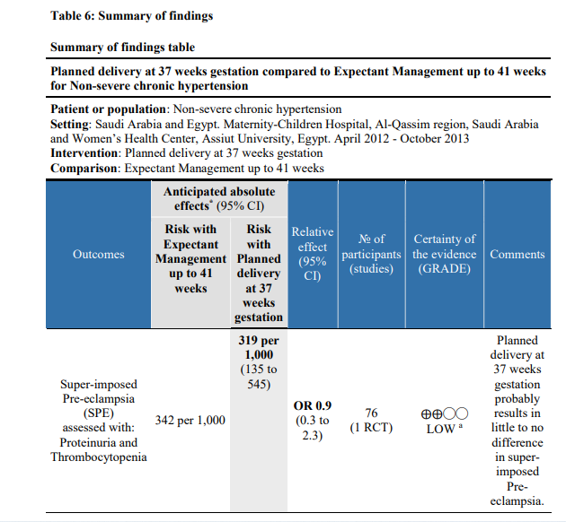
Notes:
a- Blinding of participants was not done. It is unclear whether outcome assessors were blinded. Inpatient monitoring for the intervention group could have led to more cases being reported due to the likelihood of more frequent monitoring than in the comparator group monitored as outpatients.
--Using the GRADE Pro software Guideline Development Tool (21) input data from the data extraction and risk of bias assessment tools in order to create ’Summary of findings’ tables. A summary of the intervention effect and a measure of quality for each of the outcome of interest, was obtained using the GRADE approach. This was based on five parameters namely; study limitations, consistency of effect, imprecision, indirectness and publication bias. Based on this, the evidence was downgraded from high quality by one or two levels if found to have serious or very serious limitations respectively. The quality of evidence was then classified as high, moderate or low for each outcome of interest. Table 6 displays this summary of findings.

Slide 13
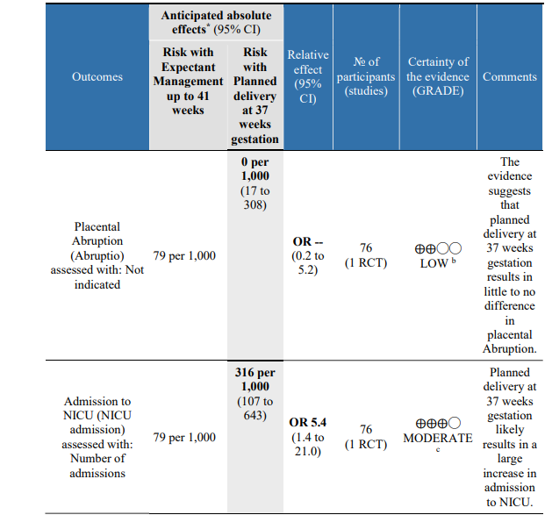
Notes:
B- Blinding of participants was not done. It is unclear whether outcome assessors were blinded. The standard of measurement for placental abruption was not indicated hence objectivity could not be assessed. It is also not clear whether the same standard was applied for both groups. Inpatient monitoring for the intervention group could have led to more cases being reported than in the comparator group monitored as outpatients
C-Blinding of participants was not done. It is unclear whether outcome assessors were blinded. The criteria used for admission to NICU was not indicated hence objectivity could not be assessed. However, this was presumably done by the neonatologists hence their treatment decisions were unlikely to have been affected by lack of blinding

Slide 14
Overall Completeness of the Evidence
The search strategy was broad and inclusive and no date or language restrictions were applied in the primary search.
One RCT deemed eligible for the final review. Reference list of the included study was searched. None of the referenced studies was eligible for inclusion.
The review protocol was registered with PROSPERO prior to starting the formal screening of articles based on eligibility criteria.
The review conducted based on the steps outlined in the protocol.
Meta-analysis not done due to limitation by number of studies. Instead, narrative synthesis was done as earlier pre-specified.

Slide 15
Potential Bias in Review Process
The assessment of risk of bias involves subjective judgements.
This potential limitation was minimized by following the procedures in the Cochrane Handbook for Systematic Reviews of Interventions .
Measurement of the level of agreement using the kappa statistic at the initial screening of articles and at the level of full text review indicated an acceptable level of agreement for systematic review.
Our search was limited to three major electronic bibliographic databases.
We did not search for unpublished trials or gray literature and no correspondence was made to experts in the area of study.

Slide 16
Implications for Practice
In the setting of non-severe chronic hypertension in pregnancy, the evidence shows that expectant management up to 41 weeks gestation could be chosen over planned delivery at 37 weeks gestation as this was associated with significantly lower rates of admission to NICU.
There is no significant difference in rates of developing super-imposed pre-eclampsia, placental abruption or perinatal mortality.

Slide 17
Implications for research
The question on optimal timing of delivery for women with non-severe chronic hypertension at term is critical but not adequately addressed by currently available literature.
There is need for high quality studies that are sufficiently powered to address the review question taking into consideration the need for allocation concealment, blinding of outcome assessors and clearly outlined methods of assessing the outcomes of interest.
These studies should also include other outcomes like maternal admission to ICU.
RCTs that include participants in different settings will improve the generalizability of the findings. This will enable combining of data from different studies to assess pooled effects in a meta-analysis.
Consequently, this will enable recommendations to be made with a higher level of certainty.

