Slide 1

PREVALENCE OF ANTIBIOTICS PRESCRIPTION AMONG WOMEN DURING CHILDBIRTH IN PUMWANI MATERNITY HOSPITAL, THE AGA KHAN UNIVERSITY HOSPITAL, NAIROBI AND KIHARA SUB COUNTY HOSPITAL- A RETROSPECTIVE STUDY
Author: George Ireri- KRCHN, BScM
Affiliation: AKUH, N

Slide 2
INTRODUCTION
Background:
There has been a substantial rise in antimicrobial prescription and intake globally.
Numerous fears have been raised concerning unwarranted use of antimicrobials and its consequent effect on antimicrobial resistance and inflated cost of healthcare (Mensah, Opoku-Agyeman, & Ansah, 2017).
Maternal sepsis remains one of the leading direct causes of maternal mortality worldwide.
Judicious antibiotic use can reduce morbidity and mortality.
However, underuse, or ineffective regimen can be harmful to mother, newborn and increase antimicrobial resistance.
Aim:
The main aim of this study was to define the prevalence of and the type of antibiotics prescribed, when and the duration of the prescription among mothers admitted in The Aga Khan university hospital, Nairobi, Pumwani maternity hospital, and Kihara sub-county hospitals postnatal wards and whether current guidelines are being followed while prescribing the antibiotics.

Slide 3
Introduction Cont.……
Specific objectives
To determine the prevalence of routine antibiotic use among mothers who delivered in The Aga Khan university hospital, Nairobi, Pumwani maternity hospital, and Kihara sub-county hospitals postnatal wards between a1st Jan 2019 to 31st Dec 2019?
To determine types of antibiotics being prescribed to mothers during childbirth Significance of the study.
To determine when the antibiotics are being prescribed during childbirth
To determine the duration of antibiotics prescription.
Research questions
What is the prevalence of antibiotic drug use during vaginal childbirth
Which antibiotics are used during childbirth?
Is there a difference in peripartum antibiotic use in private, public, and community hospitals in Kenya?
Does antibiotic use comply with national guidelines?

Slide 4
Method:
The researcher used a quantitative retrospective chart review for the files of all mothers who delivered at The Aga Khan University Hospital, Nairobi, Pumwani Maternity hospital and Kihara Sub-county Hospitals between 1st Jan to 31st Dec 2019.
Inclusion criteria
All files for women who delivered in Pumwani maternity hospital, The Aga Khan University hospital, Nairobi and Kihara sub-county hospital between 1st Jan-31st Dec 2019.
Exclusion criteria
Any file for a mother who delivered in another health facility or delivered at home and was transferred to Pumwani maternity hospital, The Aga Khan Hospital, Nairobi and Kihara sub-county hospital for further management were excluded from the study

Slide 5
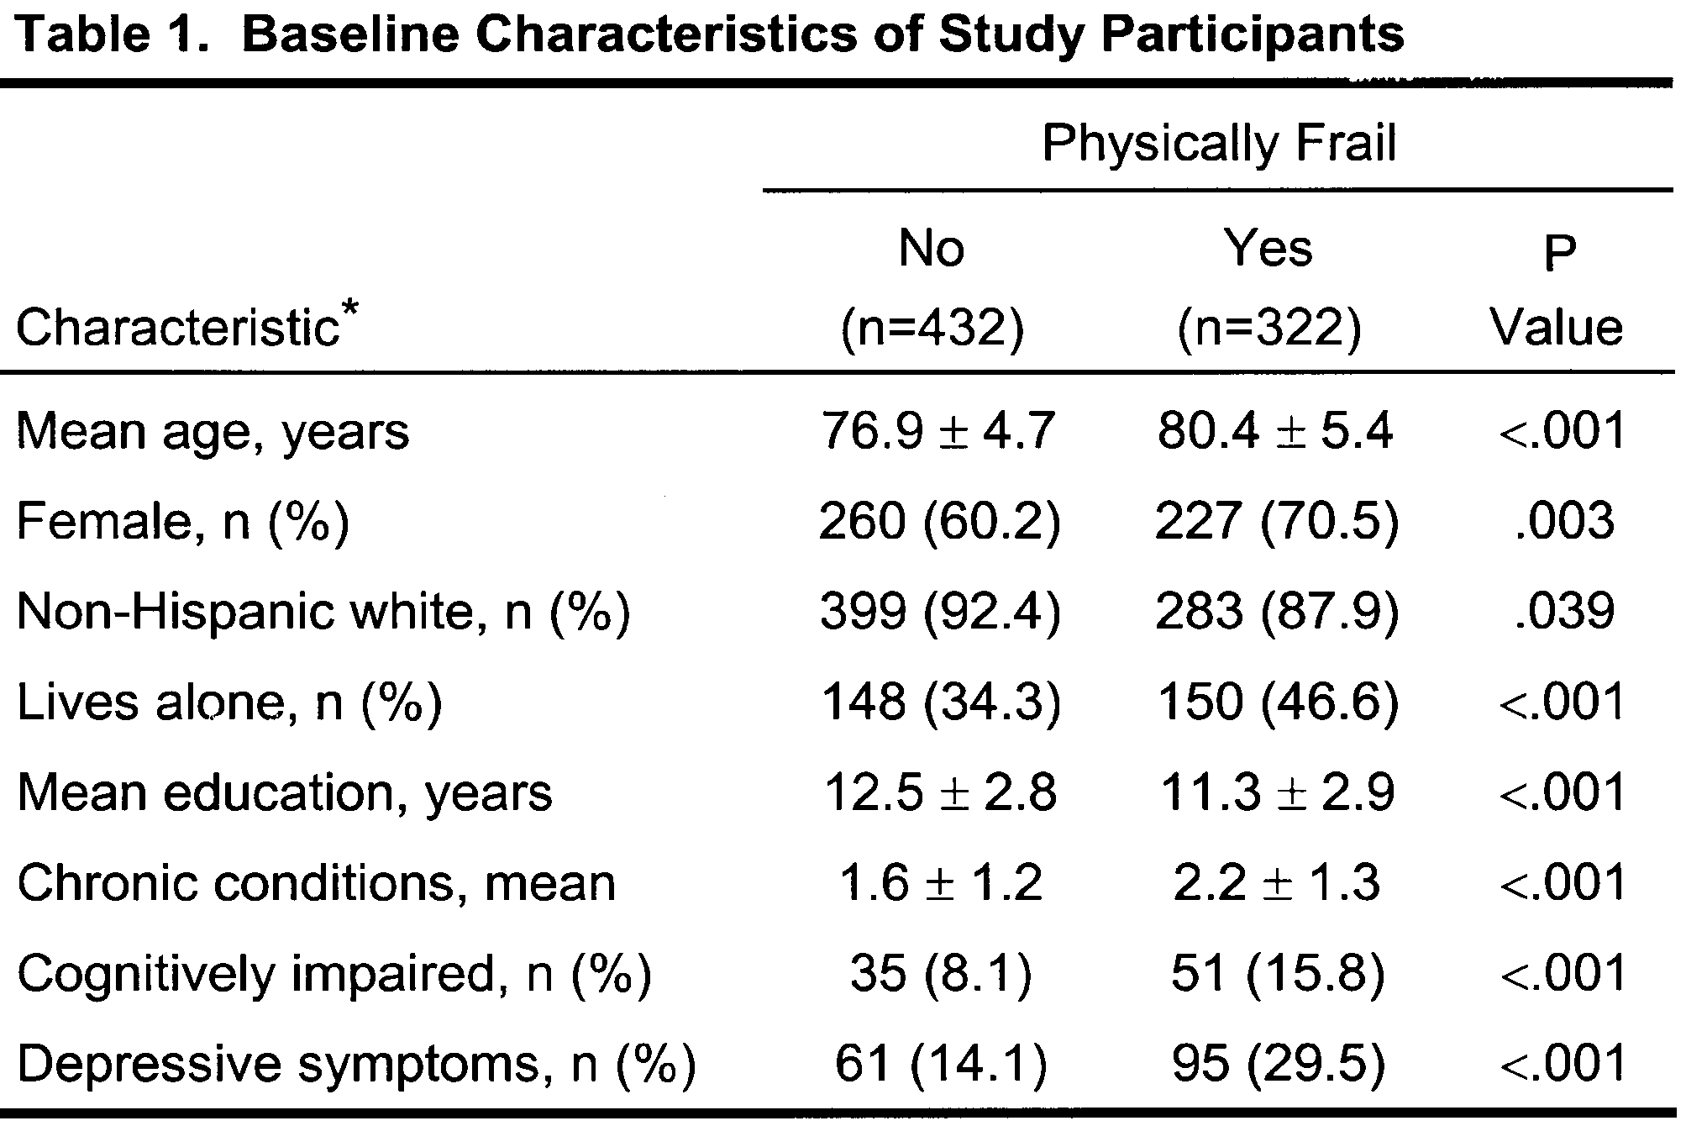

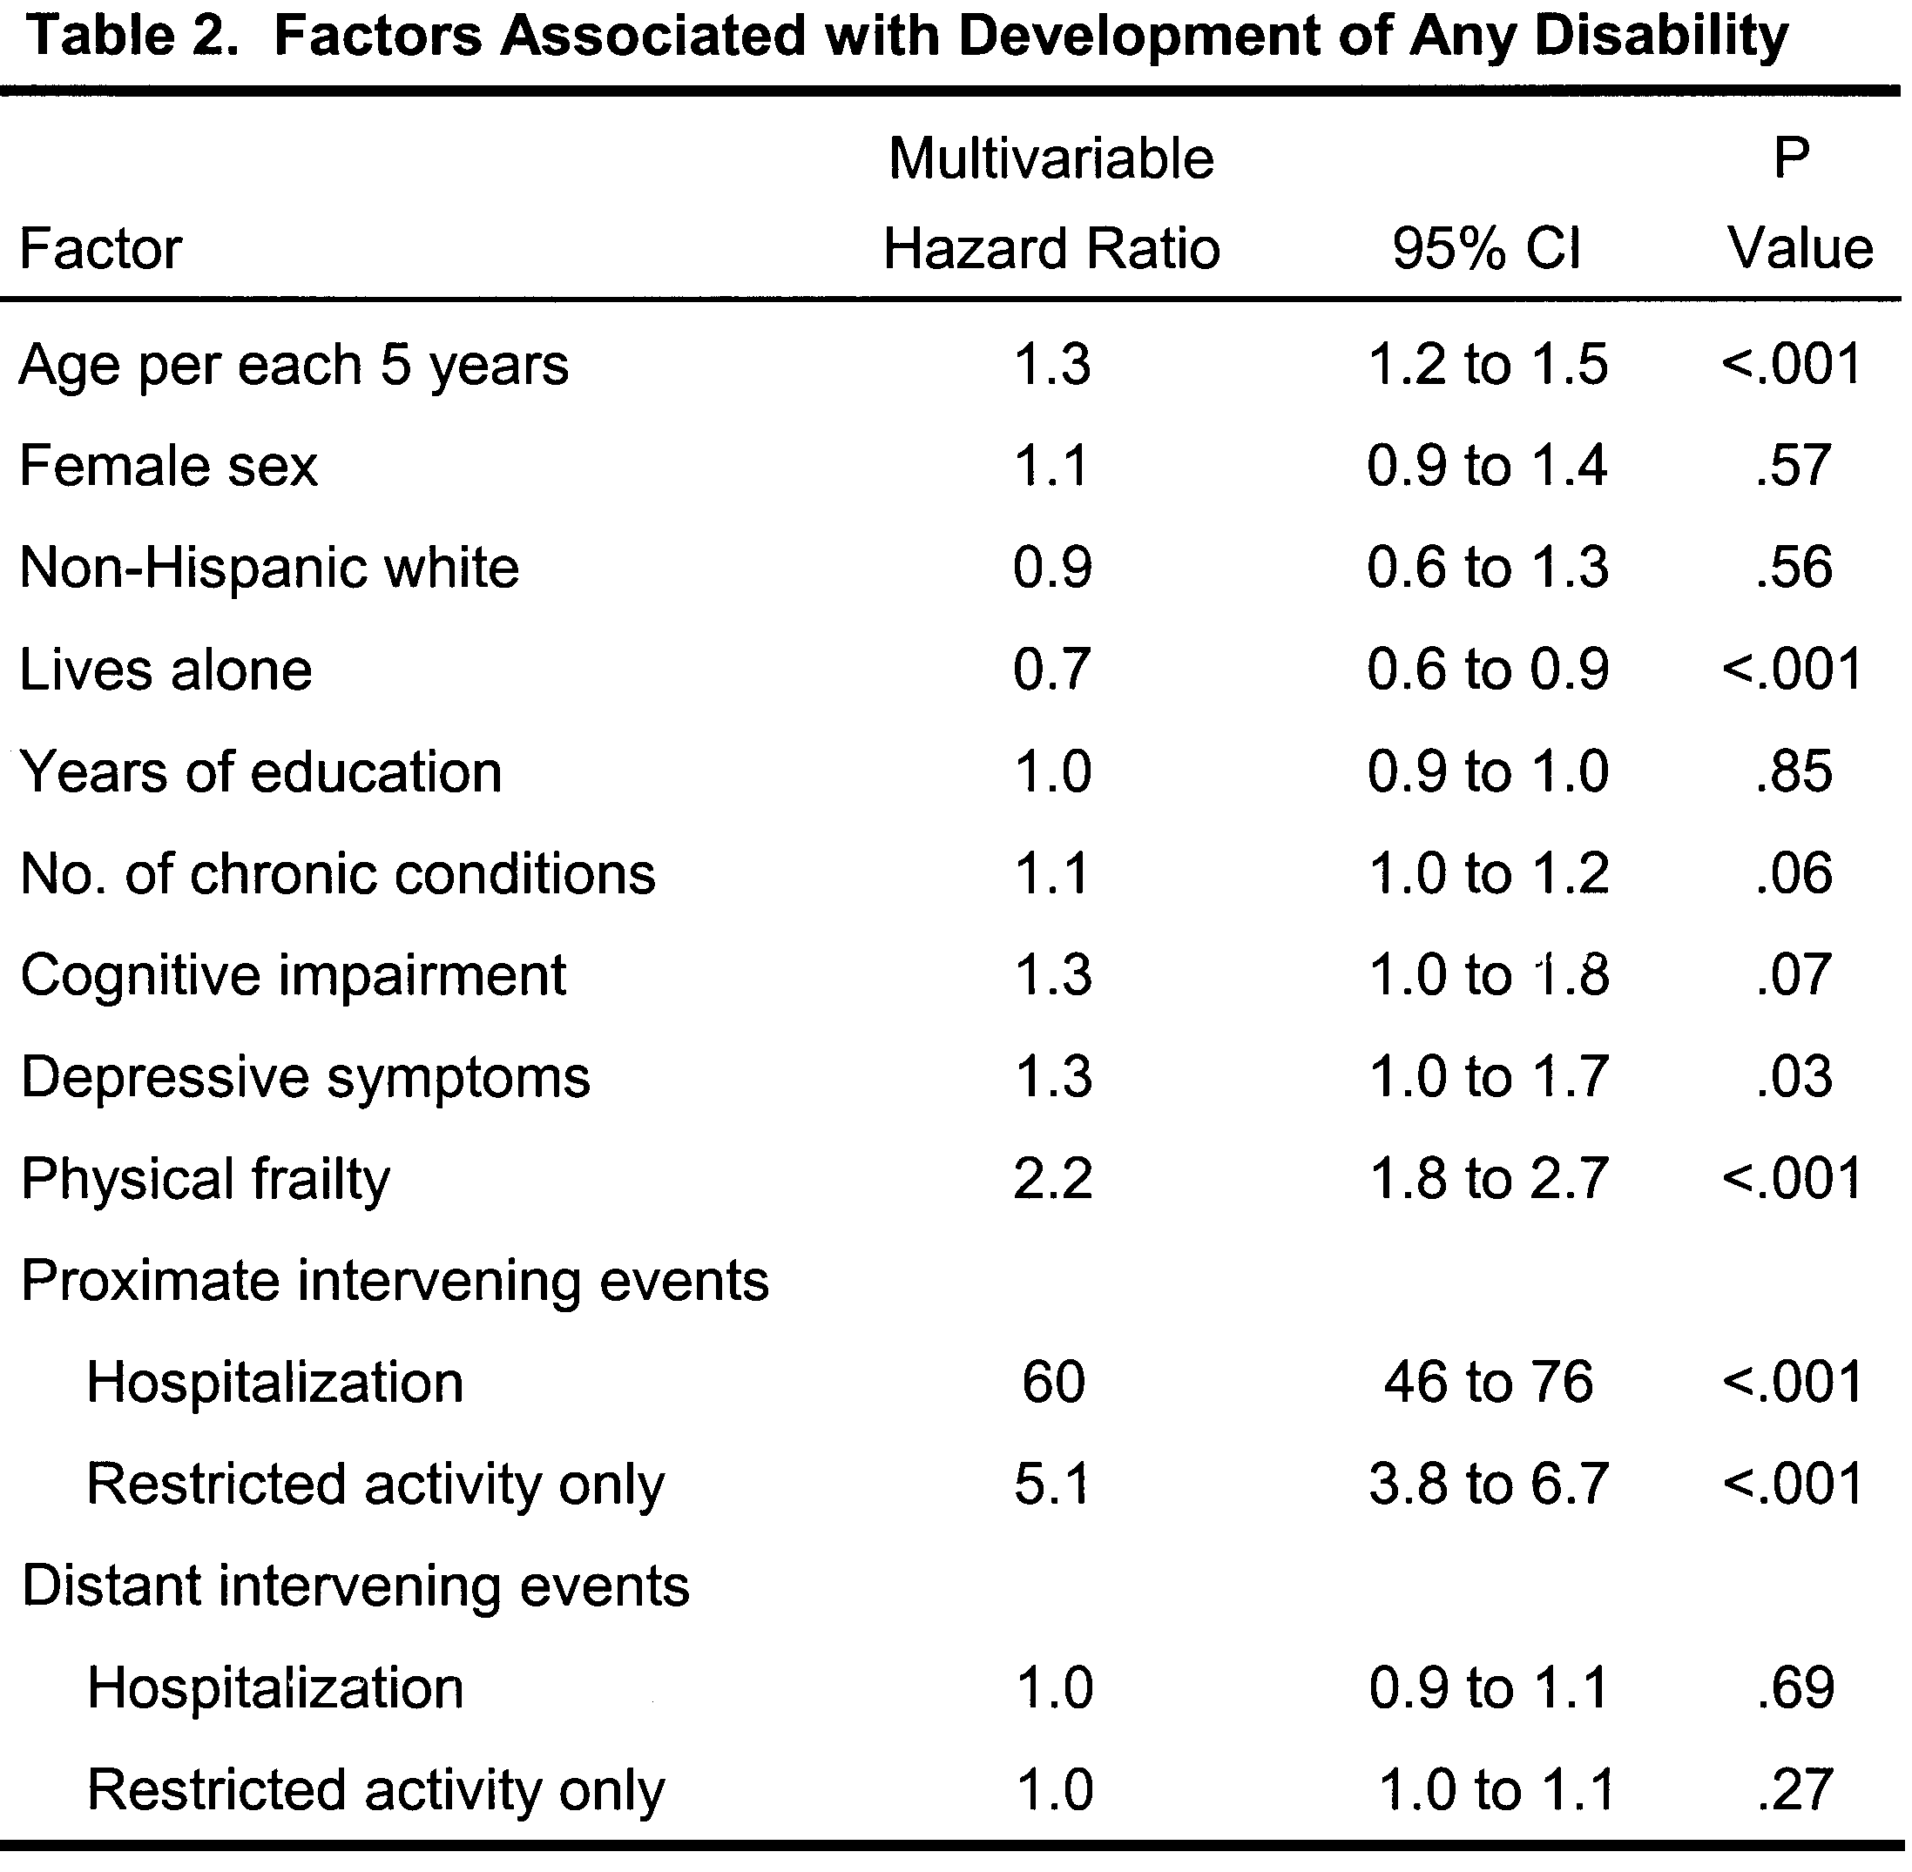
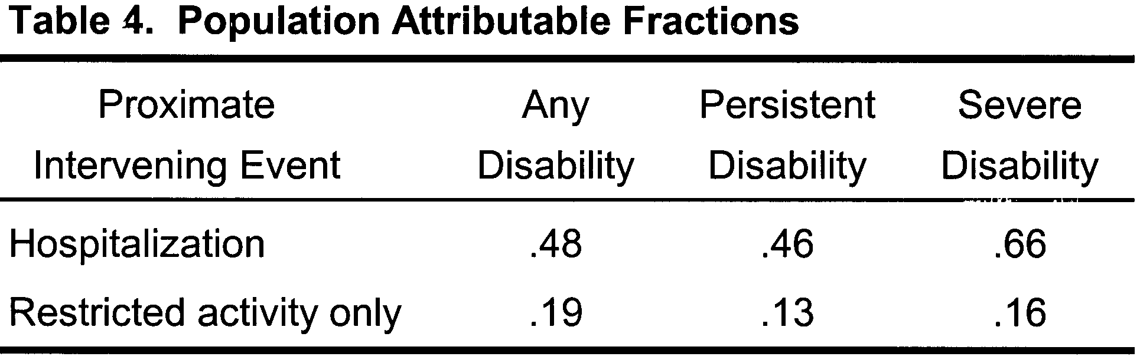
Results
Table 2: Antibiotics information
Table 1: Maternal characteristics
Table 3: Types of antibiotics
Parameter | Category | Value
Antibiotics | Yes No | 271 (47.5%) 299 (52.3%)
Time antibiotics started | Antepartum Intrapartum Postpartum | 32 (11.8%) 144 (53.1%) 95 (35%)
Prescribed dose completed | Yes No | 139 (51.2%) 132 (48.7.1%)
Remaining doses prescribed on discharge | Yes No | 61 (57.5%) 45 (42.5%)
Documented Indications for Antibiotics prescription | Yes No | 183 (67.5%) 88 (32.5%)
Parameter | Category | Value n (%)
Age in years | 15-20 Years 21-25 Years 26-30 Years 31-35 Years >35 Years | 70 (12.2%) 252 (44.2%) 84 (14.7%) 91 (15.9%) 62 (10.8%)
Parity | Primi-parous Multiparous | 258 (45.2%) 297(52.1%)
Pregnancy intervals | 1 Year 1-2 Years 2-5 Years >5Years | 0 77 (13.5%) 201(35.2%) 37 (6.5%)
Mode Of delivery | Vaginal C-Section | 357(62.6%) 214 (37.5%)
Antibiotics | Value (%)
Cephalosporins, Nitroimidazoles, Aminoglycosides | 71(26%)
Penicillins, Aminoglycosides | 68 (25.1%)
cephalosporin | 36(13.3%)
Penicillins, Aminoglycosides, Nitroimidazoles | 32 (11.8%)
Macrolide | 29 (10.7%)
Penicillins | 29 (10.7%)
Penicillins, Nitroimidazoles, Aminoglycosides | 6(2.2%)
The most commonly used cephalosporins were Zinacef and Rocephine
Penicillins used were Benzyl-penicillin and Augmentin
Aminoglycosides used were Gentamycin and Amikacin
Nitroimidazoles used were metronidazole while,
Macrolides used were Azithromycin, Erythromycin and clarithromycin.
N/B Rocephine, Amikacin and Clarithromycin were only used in Aga Khan.
GRAPH
GRAPH

Slide 6
Conclusion
This sturdy concludes that:-
Significant number of patients are being prescribed for antibiotics during Childbirth.
The available guidelines are not being followed during prescriptions
A significant number of clinicians prescribe the antibiotics without documented indication.
2nd and 3rd line antibiotics are being used without evidence of resistance to 1st line antibiotics.
This study highlights the need for prompt and adequate regulations on the use of antibiotics during childbirth.
The findings from this study can be used in formulation of policies regulating use of antibiotics during childbirth.

Slide 7
Recommendations
There is need to standardize the regimens for the antibiotics across all hospitals because different hospitals used different regiments of the antibiotics
There is need for the ministry of health to come up with guidelines for antibiotics use during childbirth because some patients were started even on 2nd line antibiotics.
More studies need to be conducted on the subject especially in Kenya since there has not been such a study that has been conducted and very few in sub Saharan Africa and globally

Slide 8
  LIMITATIONS OF THE STUDY
The Covid 19 was the major limiting factor to the study with the closing of all learning institutions; restriction of movement and social distancing, data collection was delayed for a significant period of time.
Incomplete documentation was also a challenge during data collection; some files were disqualified because they did not contain the needed information.
During literature review, it was difficult to find enough literature since there is no such research that has been conducted in Kenya on antibiotics use during childbirth.

Slide 9
Acknowledgment
DR Rachel Kimani
Management, leadership and the staff of The Aga Khan University hospital, Nairobi, Pumwani Maternity hospital and Kihara level IV hospital
Team members (BScM 2021 June Class)

