Slide 1
APPLICABILITY OF TELE-NEUROLOGY IN THE FOLLOWUP OF PATIENTS WITH NEUROLOGICAL CONDITIONS AT THE AKUH NAIROBI KENYA.
FAZAL.A.YAKUB
Supervisors:
Dr Dilraj Sokhi(Section head Neurology)
Dr. Jasmit Shah (Biostatistician)

Slide 2
Background
A systemic analysis conducted between the years 1991-2016 identified neurological conditions as the leading cause of disease adjusted life years (DALYs) and second cause of mortality after cardiovascular associated death(1)
12 out of 100 deaths globally are due to a neurological condition(2).
Sub Saharan Africa (SSA) contributes to two third of the global neurological disease burden.
Notes:
it is estimated that strokes cause 5.54 million deaths worldwide and two thirds occurs in developing countries
It is estimated that the ratio of neurologist to the population in SSA is 1:3 million in compared to European countries where the ratio is 1:20 thousand
Locally we have 14 neurologists servibg a population of 50M
The number of neurological beds serving our population in SSA are 0.03 in 10 thousand
Paucity of neurologists.
Lack of physical resources including poor infrastructure.
Lack of specialized neurological services e.g. EEG, EMG.
General lack of human resources.

Slide 3
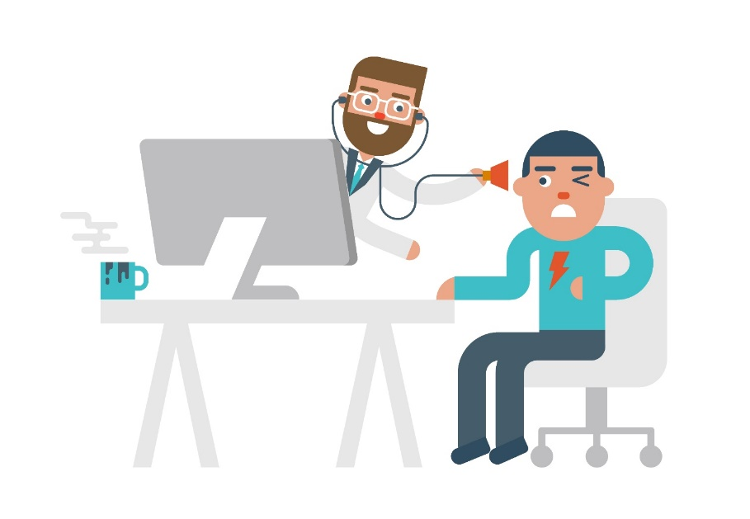
What is Tele-Neurology?
Delivery of health care services by means of electronic communication.
It serves as a means of bringing specialist services to an underserviced location.
The WHO defines it as the use of ICT to exchange valid and critical medical information between a health care provider and a patient with distance being the critical factor (3)
Synchronous Vs Asynchronous methods.
Notes:
Synchronous tele-consultation on the other hand uses real time video conferencing providing a two-way audio and video between the patient and the health care provider
The former involves utilization of texts without images such as mobile texts and emails

Slide 4

Tele-neurology around the globe.
1999-advent of “tele-stroke” emerged popularized by Levine and Gorman(5)
Data from the NIHSS showed that examinations done via tele-neurology and physically were comparable with similar outcomes after intravenous Tissue Plasminogen activator (tPA) was administered (4).
Galveston clinic and Beaumont tele-medicine clinic found no statistical differences between epileptic patients in terms of emergency visits due to breakthrough seizures or compliance to medications (5)
Rural areas such as New Mexico followed up of veterans over a period of two years with results showing a 90% satisfaction rate and 92% of the patients stating the service had saved them time and money (6).
Tele neurology was effective in the follow-up of patients with primary headaches with optimum headache control as well as identification of a secondary headache that would need further evaluation (7)
Similarly in China, the level of satisfaction in participants partaking in tele-health services demonstrated good outcomes when assessed using the tele-medicine satisfaction questionnaire (8)
Notes:
Neurological conditions form a unique subset of diseases in that there can be limitation in terms of physical mobility, restriction in the use of transportation in epileptics, cognitive functional decline and this can strain care givers.

Slide 5
Research question.
Is an outpatient tele neurology service feasible within the tertiary level Aga-Khan University Hospital?

Slide 6

Justification:
Extend neurology services to patients and facilitate easier follow up of patients.
The Covid 19 pandemic.
Notes:
The neurology department at The Aga Khan University Hospital is well known to see a myriad of patients from many countries

Slide 7
Objectives
Primary objective
To determine patient satisfaction in engaging with the proposed tele-neurology service.
Secondary objectives
To determine patient satisfaction in engaging prior one on one neurology consults.
To determine the cost benefit of patients attending tele-neurology clinic.
To determine the travel time and the waiting time to see a neurologist in the tele- neurology clinic vs traditional ambulatory clinic.
To determine carbon footprint burden in tele neurology patient’s vs traditional ambulatory

Slide 8
Methodology
Study design:
A descriptive prospective cross-sectional study.
Location of study
Aga Khan University Hospital Nairobi (AKUHN)
Study population
Patients seen at the neurology clinic at Aga-Khan University Hospital

Slide 9
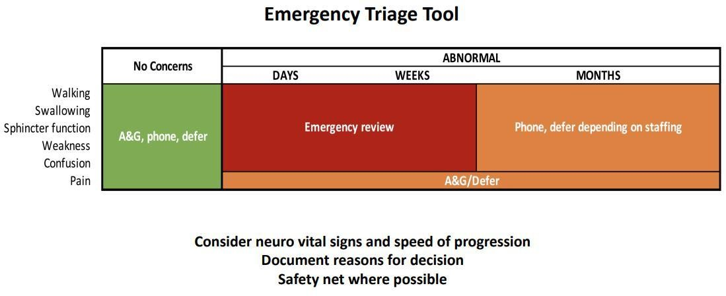
Patient recruitment:
NEUROLOGY PATIENTS
NEW PATIENTS
FOLLOW-UP
Neurologist led triage by phone
Walk in patient
Nurse led triage by phone
Triggers for F2F
Patient agrees
Patient disagrees
Tele-consultation
Neurologist led triage by phone
Triggers tele-consult
Follow-up patient
Follow-up
Triggers for F2F
Notes:
New patients are assessed on phone by a neurologist for any danger symptoms and the duration of the same.
Based on the symptomatology, patients are grouped into 2.
Patients requiring urgent face to face consultation.
Patients who can be followed up later either physically or via tele-neurology.
Safety netting arrangements

Slide 10
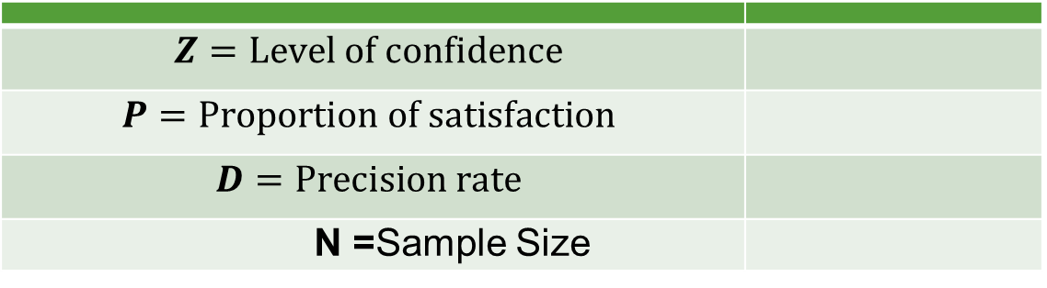

Sample size
$$N= \frac{z^{2}P (1−P)}{d^{2}}$$
$$Z=Level of confidence$$
$$P=Proportion of satisfaction$$
$$D=Precision rate$$
N =Sample Size
Proportions formula
A study by Davis et al (2014) (24) showed that 90% of the patients were fully satisfied with their tele-neurology visit.
Based on the above formula and 95% level of confidence, with 90% satisfaction rate, and 5% precision rate, the minimum sample size required for our study would be 122 patients.
After adjusting an attrition rate of 15%, the minimum required sample size for this study would be 140 patients.
Notes:
This was based on using a finite population of about 800-1000 patients seen per year.

Slide 11
Methodology
Data were entered on Redcap.
1.) To determine patient satisfaction in engaging with our proposed tele neurology service.
Expressed in frequencies and percentages
2.) To determine the cost benefit, time utilized and carbon footprint burden in tele-neurology patients versus patients attending traditional ambulatory clinic.
The variables were summarized as mean & standard deviation or median & interquartile range.
A normality test (Shapiro-Wilk) was done on continuous data for validating if the data followed a normal distribution
Notes:
In general, all categorical data will be presented as frequencies and percentages whereas all continuous data will be presented as means and standard deviation or median and interquartile range. A normality test (Shapiro-Wilk) will be done on continuous data for validating if the data follows a normal distribution.

Slide 12
Demographic Characteristics (N = 146) |  | n | %
Age (Years) (mean [SD]) |  | 44.0 [16.5]
Age (Years) (median [IQR]) |  | 40.9 [30.6, 55.2]
Gender | Male | 54 | 37.0%
 | Female | 92 | 63.0%
Duration (months)
Disease | Ataxia | 1 | 0.7%
 | Bells palsy | 1 | 0.7%
 | Burning scalp syndrome | 1 | 0.7%
 | carpal tunnel | 1 | 0.7%
 | Cluster headaches | 1 | 0.7%
 | CRION | 1 | 0.7%
 | Dementia | 12 | 8.2%
 | Dystonia | 1 | 0.7%
 | Epilepsy | 38 | 26.0%
 | Fibromyalgia/Functional disorder | 1 | 0.7%
 | Fibromyalgia/MDD | 1 | 0.7%
 | Functional disorder | 1 | 0.7%
 | Headache | 1 | 0.7%
 | Herpetic neuralgia | 1 | 0.7%
 | HIE | 1 | 0.7%
 | IIH | 4 | 2.7%
 | Migraine | 38 | 26.0%
 | MND | 1 | 0.7%
 | MS | 3 | 2.1%
 | Myasthenia Gravis | 5 | 3.4%
 | Neuropathy | 9 | 6.2%
 | Occipital Neuralgia | 1 | 0.7%
 | Parkinsons | 9 | 6.2%
 | Spondylosis | 2 | 1.4%
 | Stroke | 6 | 4.1%
 | Syrinx | 1 | 0.7%
 | Tremor | 2 | 1.4%
 | Trigeminal neuralgia | 2 | 1.4%
 | Vertigo | 1 | 0.7%
RESULTS:
219 patients enrolled:
146 responded to a TNC.
108 had previously had F2F.
-Female: 63.0%
-Median Age: 40.9 years
(IQR 30.6,55.2)
-Most common dx: Epilepsy, Migraines 26%.
-4/146 from neighboring countries.

Slide 13
For Tele-neurology consultation:
The mean level of satisfaction was 4 (SD 1).
Saved time [3.0 (2.0-4.0) hours]
Travel [11.0 (7.2-21.1) km]
Cost [$10 (5-20)];
In total, our TNC service saved our patients $6,125, 1,143 hours, and 25,506km of travel, equating to 3.5 tons (21 trees) of carbon dioxide emissions.
Post Tele Service Survey (n = 146)
 | Disagree | Neutral | Agree
I am satisfied with the care received in tele-medicine (n=145) | 8 (5.5%) | 12 (8.3%) | 125 (86.2%)
My family is satisfied with the care received in tele-medicine | 8 (5.5%) | 28 (19.2%) | 110 (75.3%)
Tele-medicine helps me know my state of health | 11 (7.5%) | 27 (18.5%) | 108 (74.0%)
I felt comfortable talking to my specialist doctor through a microphone | 7 (4.8%) | 7 (4.8%) | 132 (90.4%)
Talking to my specialist was as effective as in person | 22 (15.1%) | 28 (19.2%) | 96 (65.8%)
My specialist doctor has identified my health problem through tele-medicine | 22 (15.1%) | 40 (27.4%) | 84 (57.5%)
The quality of sound were adequate to talk to my specialist doctor | 4 (2.7%) | 8 (5.5%) | 134 (91.8%)
The time with a specialist is faster with tele medicine | 6 (4.1%) | 14 (9.6%) | 126 (86.3%)
I prefer telemedicine because it is easier than to go to the hospital (n=145) | 18 (12.4%) | 22 (15.2%) | 105 (72.4%)
Telemedicine saves me time travelling to hospital or a specialist clinic | 8 (5.5%) | 5 (3.4%) | 133 (91.1%)
My specialist doctor was able to answer my questions through telemedicine (n=145) | 4 (2.8%) | 8 (5.5%) | 133 (91.7%)
I find telemedicine an acceptable way to receive health-care services | 13 (8.9%) | 23 (15.8%) | 110 (75.3%)
I will use telemedicine services again | 6 (4.1%) | 22 (15.1%) | 118 (80.8%)
I trust that my personal information and privacy will be protected after my attention by tele medicine (n=143) | 3 (2.1%) | 10 (7.0%) | 130 (90.9%)
*Disagree is aggregated with Totally Disagree; *Agree is aggregated with Totally Agree
Notes:
90%Felt satisfied with the care and that their neurological concerns were adequately addressed
Would use TNC again
Found it just as comfortable and not in violation of their privacy.
*Conversely, 15.1% (22/146) did not agree with TNC being as effective as F2F, including the neurologist identifying all their health problems satisfactorily

Slide 14
CONCLUSION:
Spectrum of disorders locally and at a global context mirror each other (7,8,9.)
Our study demonstrates that our regionally unique TNC service is an acceptable, efficient, effective, and environmentally-friendly care delivery model in our resource-poor setting.

Slide 15
ASANTE! ☺

Slide 16
REFERENCES.
1. Feigin VL, Nichols E, Alam T, Bannick MS, Beghi E, Blake N, et al. Global, regional, and national burden of neurological disorders, 1990–2016: a systematic analysis for the Global Burden of Disease Study 2016. The Lancet Neurology. 2019;18(5):459-80.
2.Sarfo FS, Adamu S, Awuah D, Ovbiagele B. Tele-neurology in sub-Saharan Africa: A systematic review of the literature. Journal of the neurological sciences. 2017;380:196-9.
3. Aarli JA, Diop AG, Lochmüller H. Neurology in sub-Saharan Africa: a challenge for World Federation of Neurology. Neurology. 2007;69(17):1715-8.
4.Wechsler LR. Advantages and limitations of teleneurology. JAMA neurology. 2015;72(3):349-54.
5. Rasmusson KA, Hartshorn JC. A comparison of epilepsy patients in a traditional ambulatory clinic and a telemedicine clinic. Epilepsia. 2005;46(5):767-70.
6. Davis LE, Coleman J, Harnar J, King MK. Teleneurology: successful delivery of chronic neurologic care to 354 patients living remotely in a rural state. Telemedicine and e-Health. 2014;20(5):473-7
7. Morgan DG, Kosteniuk J, Stewart N, O'connell ME, Karunanayake C, Beever R. The telehealth satisfaction scale: reliability, validity, and satisfaction with telehealth in a rural memory clinic population. Telemedicine and e-Health. 2014;20(11):997-1003.
8. 20(11):997-1003.Yip M, Chang AM, Chan J, MacKenzie AE. Development of the Telemedicine Satisfaction Questionnaire to evaluate patient satisfaction with telemedicine: a preliminary study. Journal of Telemedicine and Telecare. 2003;9(1):46-50.

