Slide 1
KNOWLEDGE, ATTITUDE AND PRACTICE OF BASIC TRAUMA LIFE SUPPORT AMONG BODA BODA RIDERS IN KILIFI COUNTY
Dr. Faraj Alkizim - BSc, MBChB, MSc, MMED (Ortho)
Orthopaedic Surgeon

Slide 2
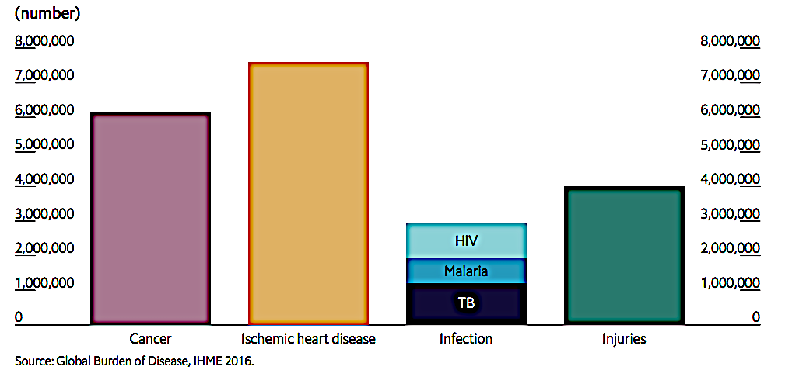
INTRODUCTION

Slide 3
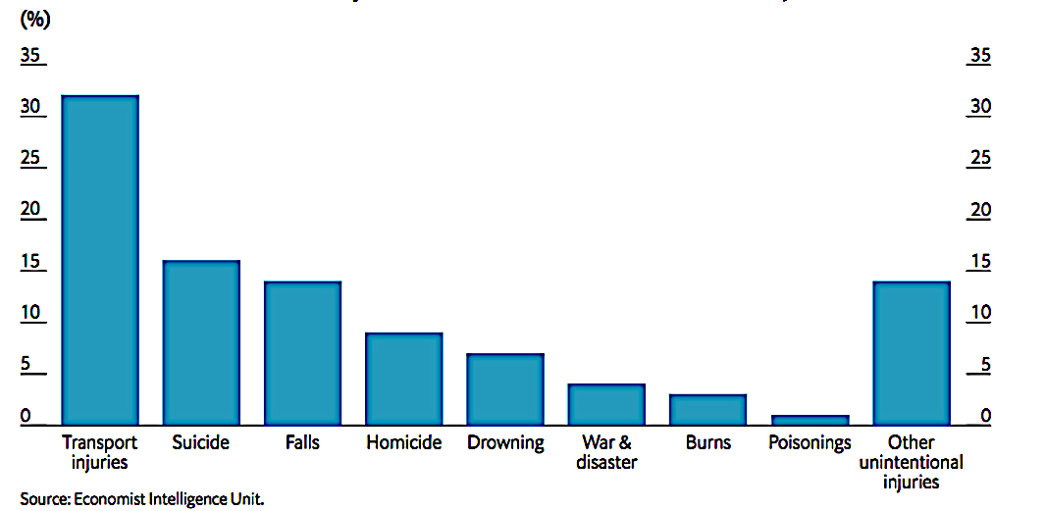

Slide 4
2020

Slide 5
Motor cycles in Kenya

Slide 7
Source: https://www.pinterest.com/pin/348114246174996008/

Slide 8
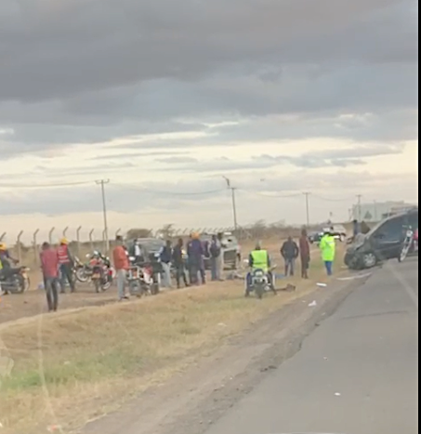
8

Slide 9
METHODOLOGY
Study design: A community based cross-sectional study
Sampling procedure: Multistage convenient sampling
Semi structured questionnaire.
Informed consent

Slide 10
SOCIO-DEMOGRAPHIC CHARACTERISTICS OF THE PARTICIPANTS
Mean age 29 years (range 17-54)
Married 68%
Education:
  Primary 50%
  Secondary – 40%
  Tertiary – 10%

Slide 11
EXPOSURE AND INVOLVEMENT IN ROAD TRAFFIC ACCIDENTS
More than 90% work > 6 days a week >=12 hours a day

Slide 12
Time it takes for the riders to arrive at accident scenes, proportion that stop at the scenes and assistance that they offer to victims
No knowledge– 43%
No equipment – 26%
Scared – 21%
No time – 10%

Slide 13
Training in BTLS

Slide 14
Attitude towards BTLS

Slide 15
Basic knowledge on airway among the riders

Slide 16
Handling of the cervical spine

Slide 17
Breathing
Assessment:
  30% had some knowledge
Intervention:

Slide 18
Management of an open wound to the chest

Slide 19
Circulation

Slide 20
Disability
Handling of an unconscious patient

Slide 21
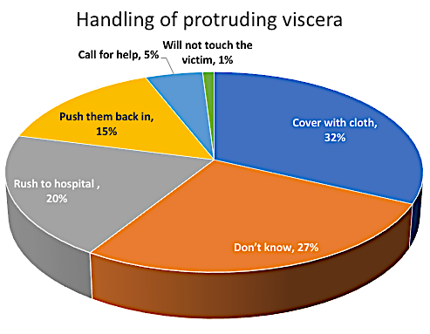
Handling of penetrating injury
Exposure
Object:
  72% will not remove
  28% will remove

Slide 22
Exposure
Handling of a suspected pelvic injury patient

Slide 23
Exposure
Identification of a possible fracture

Slide 24
Exposure
Handling of a fractured limb

Slide 25
DISCUSSION & CONCLUSION
Boda boda riders spend abundant time on the roads
Heavily involved in providing emergency care to RTA victims
Very little knowledge and skills in correct handling of victims
Practice is poor
May be causing more harm
Very positive attitudes towards BTLS
Willing to learn

Slide 26
RECOMMENDATIONS
Training boda boda riders in BTLS will go a long way in reducing RTA morbidities and mortalities

Slide 27
RECOMMENDATIONS
BTLS training to be a mandatory requirement for public service transporters including boda boda riders
First aid teaching to be reintroduced in school curricula.

Slide 28
Simple ideas…
…save lives

