Slide 1
A COMPARISON OF INTERGROWTH-21ST FORMULA TO HADLOCK METHOD OF ESTIMATING FETAL WEIGHT IN LOW-RISK PREGNANCIES
Presenter: Dr Esther Simiyu
Co-authors: Dr Sikolia Wanyonyi, Prof Marleen Temmerman, Prof Sudhir Vinayak

Slide 2
Background
Fetal weight estimation is an important component of fetal growth assessment (1).
There are many ultrasound methods used for this, Hadlock formula has been found to be most reliable
It relies on abdominal circumference(AC), head circumference(HC) and femur length(FL) to calculate the fetal weight (2).
The Intergrowth 21st group developed a new formula to estimate fetal weight using AC and HC. (6)
Studies done have primarily compared Hadlock to older methods in use and focussed on a preterm population, not stratified according to risk.
Limited studies comparing the 2 methods using percentiles. Kong Et al compared Intergrowth to Hadlock using absolute estimated fetal weight (EFW) found Hadlock to be superior (5).
Notes:
Fetal growth abnormalities are a known cause of morbidity and mortality.
Hadlock is the current standard of care in AKUH-N
Ingergrowth with new international growth standards
Monier et al compared the 2 methods in a preterm population in France between 22-34weeks gestation (2).
We therefore sought to compare Hadlock to the newer Intergrowth 21st method in a low-risk population, at or near term.

Slide 3
Question: How does Intergrowth 21st method compare to Hadlock formula in estimating fetal weight in low-risk pregnancies?
Primary Objective: To compare Intergrowth 21st method with Hadlock formula in estimating fetal weight in low-risk pregnancies
Secondary Objective: To determine factors affecting the accuracy of Intergrowth 21st method and Hadlock formula in estimating fetal weight.
Variables:
Ultrasound to delivery interval.
Fetal sex.
Maternal BMI.
Fetal Size: small for gestational age(SGA),Large for gestational age (LGA), Normal weight.
Null Hypothesis: There is no difference between Intergrowth 21st and Hadlock Method in estimating fetal weight in low-risk pregnancies.
Research Question/
Objectives

Slide 4
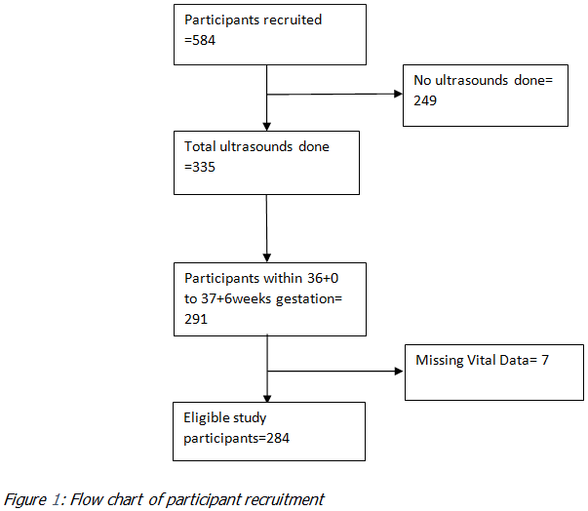
Methodology
Study Design: Our study was a secondary analysis of data collected from the Parent Study.
Study Population:Women attending antenatal clinic and who delivered at AKUH-N with an obstetric ultrasound between 36+0-37+6 weeks gestation.
Inclusion Criteria: Women between 36⁺⁰ and 37⁺⁶ weeks gestation with low-risk pregnancies.
Exclusion Criteria: All high-risk women as per the parent study.
The sample size was determined using the formula below (Rosner, 2016):
  n = E(Z_{α/2}+Z_{β})² /( E/S(Δ))²
  (power of 80% and a 5% level of significance)
Notes:
The parent study aimed to determine if routine use of ultrasound in late 3rd trimester increases the detection rate of FGR/SGA fetus (3).
Routine third trimester ultrasound for the detection of small for gestational age in low risk pregnancies (ROTTUS) – A non-inferiority randomized, control trial’
Criteria:
. Age ≥18 and <45 years.
Singleton pregnancies.
Women who deliver in AKUH-N

Slide 5
Methodology
The EFW using Hadlock formula, maternal and neonatal characteristics were obtained from the ROTTUS study.
EFW using IG-21 was calculated using an excel based formula (Hoopmann et al., 2010) :
            Log_{e}(EFW) = 5.084820 - 54.06633 × (AC/100)³ - 95.80076 × (AC/100)³ × log_{e}(AC/100) + 3.136370 × (HC/100) [g,cm]
Data was input on a Microsoft Excel data collection tool and analysis done using STATA version 16 software.
Accuracy of the 2 formulas was compared using:
  1. The mean absolute percentage error.
  2. Receiver operating characteristics (ROC) curve analysis: The EFW centiles were grouped into 3 categories: LGA >90th centile, SGA <10th centile, Normal weight 10-90th centile).
  3. The proportion of fetuses with an EFW within ±15% of birthweight (used as a marker of acceptable margin of error).
A logistic regression model was constructed for the two ultrasound formulas based on EFW within ±15% of birthweight as the dependent variable,
Notes:
Data on the gestational age at the time of the scan and HC were abstracted from ultrasound forms and reports.
MAPE = (EFW - birthweight) / birthweight x 100 ( using paired t tests or Wilcoxon signed rank test)

Slide 6
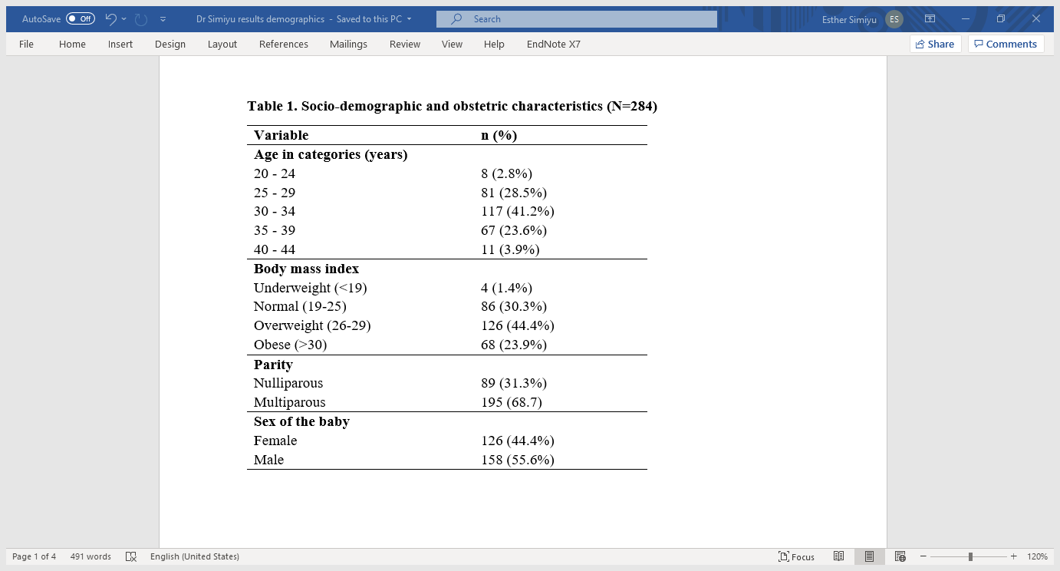
Results

Slide 7
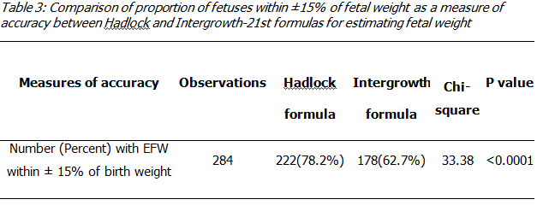
Results: Comparison of Measures of Accuracy Using Absolute Weights
Hadlock and Intergrowth-21st had a MAPE of -7.2 and -10.1 respectively (P<0.0001).
Both formulas had the tendency to underestimate the fetal weight.

Slide 8
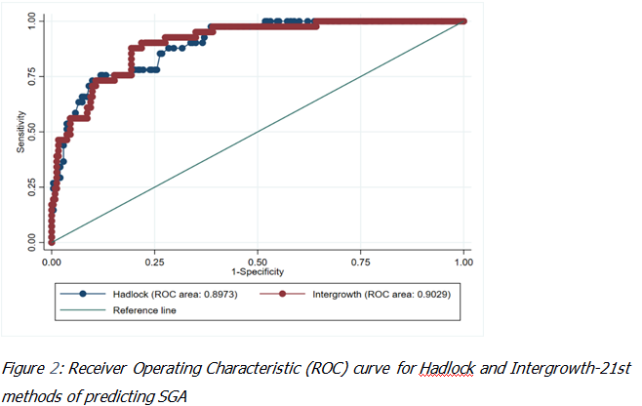
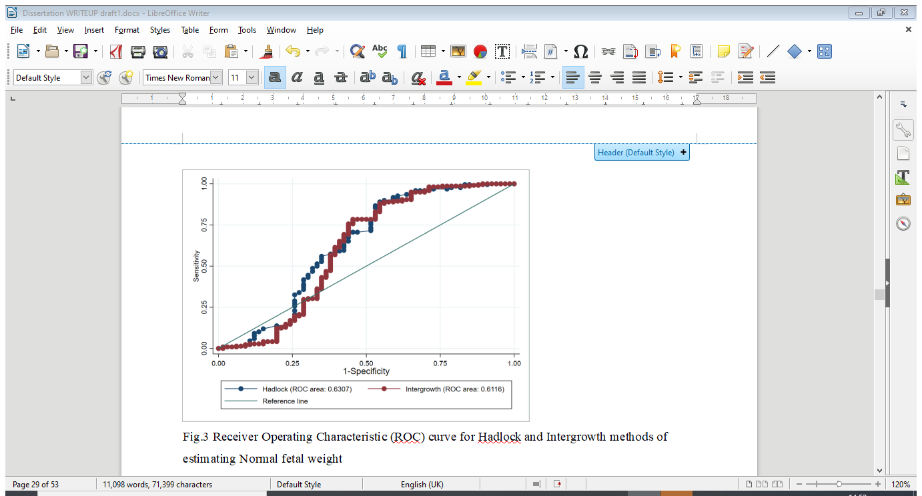
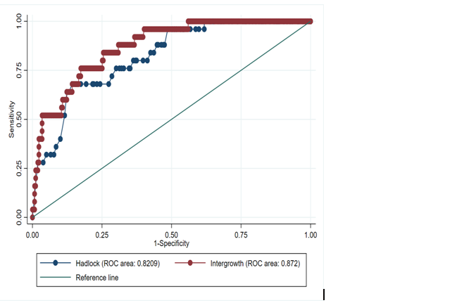
Results
The AUC for Hadlock was 0.82092 (P=0.0393; 95% CI 0.74347-0.89838) and for Intergrowth-21st method was 0.872 (P=0.0393; 95% CI 0.80865-0.93544) .

Slide 9
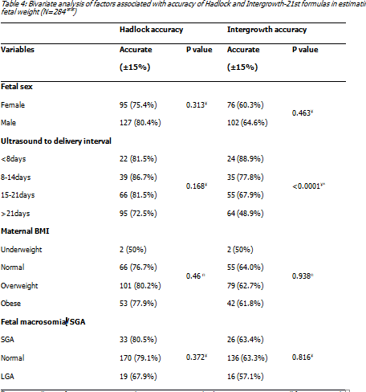
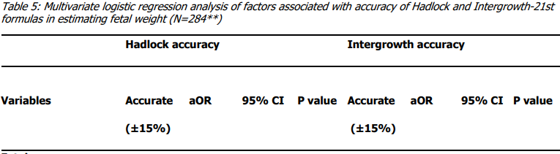
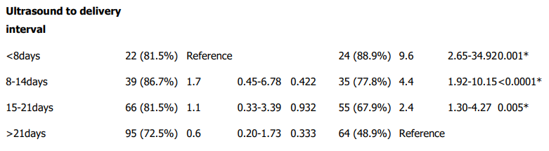

Slide 10
Discussion
The goal of this study was to compare the accuracy of Hadlock with Intergrowth-21st method in estimating fetal weight in low-risk pregnancies.
We found that Hadlock was more accurate than Intergrowth-21st method.
Similarly, a secondary analysis performed in France (2) where the proportion of fetuses with an EFW within ±15% of the birth weight was 86.8% and 78.2% (p<0.001).
Hadlock and IG-21st use 3 and 2 parameters respectively which could explain this difference in accuracy.
Both methods had a tendency towards underestimating fetal weight as demonstrated in a study by Sovia et al.
Notes:
Similarly, a secondary analysis performed in France (2) where the proportion of fetuses with an EFW within ±15% of the birth weight was 86.8% and 78.2% (p<0.001).
Formulas with more biometric parameters are postulated to perform better in predicting EFW (Chinedu et al).
Scans done in gestations >28weeks underestimated fetal weight. Scans in this study were done from 36weeks gestations.

Slide 11
Discussion
  Intergrowth-21st method was more accurate than Hadlock in estimating the fetal weight of LGA fetuses (AUC 0.87 and 0.82; P=0.0393;)
  Despite the difference between the two methods, Hadlock had a good accuracy with more than 80% chance of correctly predicting LGA fetuses.
  There was no statistically significant difference between Hadlock and IG-21st in predicting SGA fetuses (AUC 0.8973,0.9029 respectively; p=0.79)
Ultrasound-to-delivery interval had a significant association with accuracy of EFW when Intergrowth-21st method was used. With decreasing accuracy as the interval increased.
Studies done in France and Hong Kong also found similar results both methods (2,5).
This study did not find any association between maternal BMI and accuracy of ultrasound in either method.
Notes:
This differed from a prospective cohort study in which Hadlock was slightly more accurate in predicting LGA fetuses than IG-21st method (AUC=0.85, 0.83 respectively, p<0.0001)
It was conducted in a population with 4.6% of LGA fetuses. Our study however had almost five times the rate of LGA fetuses (26%)

Slide 12
Conclusion
Hadlock method was more accurate than Intergrowth-21st method in estimating fetal weight in low-risk pregnancies.
While Intergrowth-21st method was more accurate in predicting large for gestational age fetuses, Hadlock also had a good accuracy in this category.
Both methods had a tendency to underestimate the fetal weight hence clinicians should factor this in during interpretation of the estimated fetal weight.
Recommendations
There was no justification to replace the Hadlock method with the Intergrowth-21st method.
We recommend use of the clinician’s judgment in unique circumstances (such as large for gestational age fetuses) when deciding which method to use as well as interpreting the results.
Further multi-centre studies comparing Hadlock formula and Intergrowth-21st method particularly in populations with large and small for gestational age fetuses are needed.

Slide 13
References
Predict small for gestational age and short-term neonatal outcomes. J Matern Fetal Neonatal Med. 2020 Jun;33(11):1906-1912. doi: 10.1080/14767058.2018.1533945. Epub 2019 Jan 6.
Monier, I., Ego, A., Benachi, A., Ancel, P.-Y., Goffinet, F., & Zeitlin, J. Comparison of the Hadlock and INTERGROWTH formulas for calculating estimated fetal weight in a preterm population in France. American Journal of Obstetrics and Gynaecology.2018; 219(5). doi.org/10.1016/j.ajog.2018.08.012
S. Wanyonyi , J.Orwa, H. Ozelle, J. Martinez. Routine third‐trimester ultrasound for the detection of small‐for‐gestational age in low‐risk pregnancies (ROTTUS) study: a randomized controlled trial. Ultrasounds in Obstetrics and Gynecology. 2021; 21. doi.org/10.1002/uog.23618
Roma E, Arnau A, Berdala R, Bergos C, Montesinos J, Figueras F. Ultrasound screening for fetal growth restriction at 36 vs 32 weeks' gestation: a randomized trial (ROUTE). Ultrasound Obstet Gynecol. 2015 Oct;46(4):391-7. doi: 10.1002/uog.14915.
Kong C, To W. Comparison of the accuracy of INTERGROWTH-21 formula with other ultrasound formulae in fetal weight estimation. Ultrasound in Obstetrics & Gynaecology. 2018;52:105. doi:10.1002/uog.19515
Villar, J., Papageorghiou, A. T., Pang, R., Ohuma, E. O., Ismail, L. C., Barros, F. C., Kennedy, S. H. The likeness of fetal growth and newborn size across non-isolated populations in the INTERGROWTH-21st Project: The Fetal Growth Longitudinal Study and Newborn Cross-Sectional Study. The Lancet Diabetes & Endocrinology. 2014;2(10), 781-792. doi:10.1016/s2213-8587(14)70121-4
Huber C, Zdanowicz JA, Mueller M, Surbek D. Factors Influencing the Accuracy of Fetal Weight Estimation with a Focus on Preterm Birth at the Limit of Viability: A Systematic Literature Review. Fetal Diagnosis and Therapy. 2014;36(1):1–8. doi: 10.1159/000358518

