Slide 1

Preadmission Testing for SARS COV-2 as a Screening Strategy for COVID-19: A Retrospective Chart Review of Patients Admitted at a tertiary teaching and referral hospital
David Echesa Odada¹, James Ndai¹, Jemimah Kimeu¹, Jasmit Shah², Reena Shah ²

Slide 2
Introduction
COVID-19 pandemic since March 2020
Challenges in prevention and control of COVID-19 transmission
  Asymptomatic transmission of COVID-19
Evaluating mandatory preadmission testing of COVID-19

Slide 3
Methodology
A descriptive retrospective chart review
  Assess the prevalence of incidental SARS COV-2
  Describe symptom presentation of patients with positive preadmission COVID-19 results
  Explore effects on care incidental COVID-19 has on patients

Slide 4
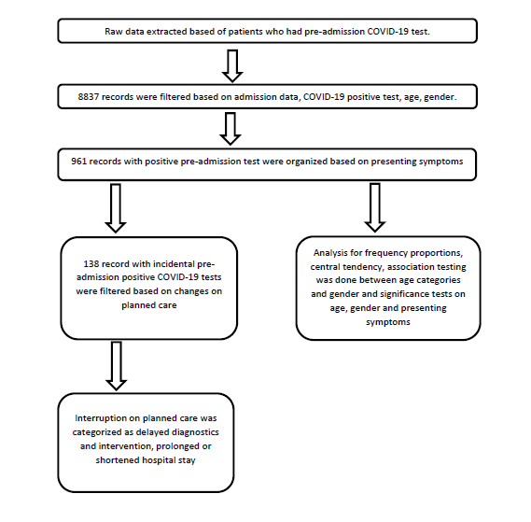
Methodology

Slide 5
Findings
COVID-19 prevalence rate of 10.9%(961/8837) at admission
Rate of Incidental positive tests was 14% (138/961)
Patients with Incidental COVID-19 had a significant low mean age (40 years) compared with the overall COVID-19 mean age (52 years)
Female gender and age range 31 years to 60 years have higher odds of incidental COVID-19
Incidental COVID-19 affected patients plan of care 21.7% (30/138)

Slide 6
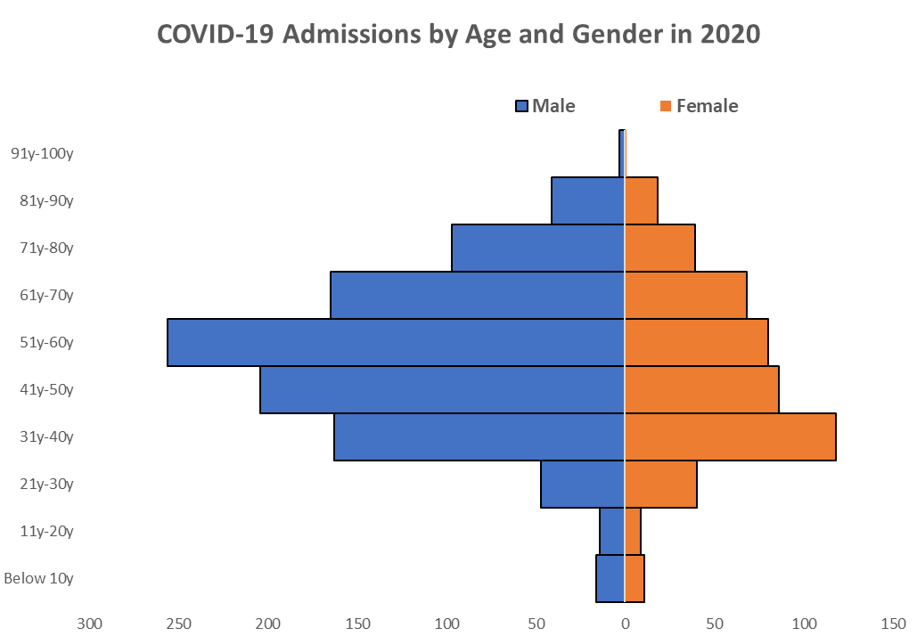
Findings
Age and Gender Admission Distribution
Association of age by gender and incidental COVID-19

Slide 7
Findings
Association of COVID-19 with symptom status

Slide 8
Findings
Binary logistic regression model for age categories and gender as the predictor for incidental COVID-19.

Slide 9
Conclusion
Double figure prevalence rate of COVID-19 supports rationale for containment measures
Pre-admission COVID-19 testing is an effective strategy of controlling COVID-19 transmission in hospitalized patients
Patient care planning and preparation should consider possibilities of incidental COVID-19

