Slide 1
Notes:
Objective: launch the Series in this region and gather you all – important stakeholders – together to generate discussion, debate and agree on a roadmap to tackle SVNs in our region – concrete actions!

Slide 2
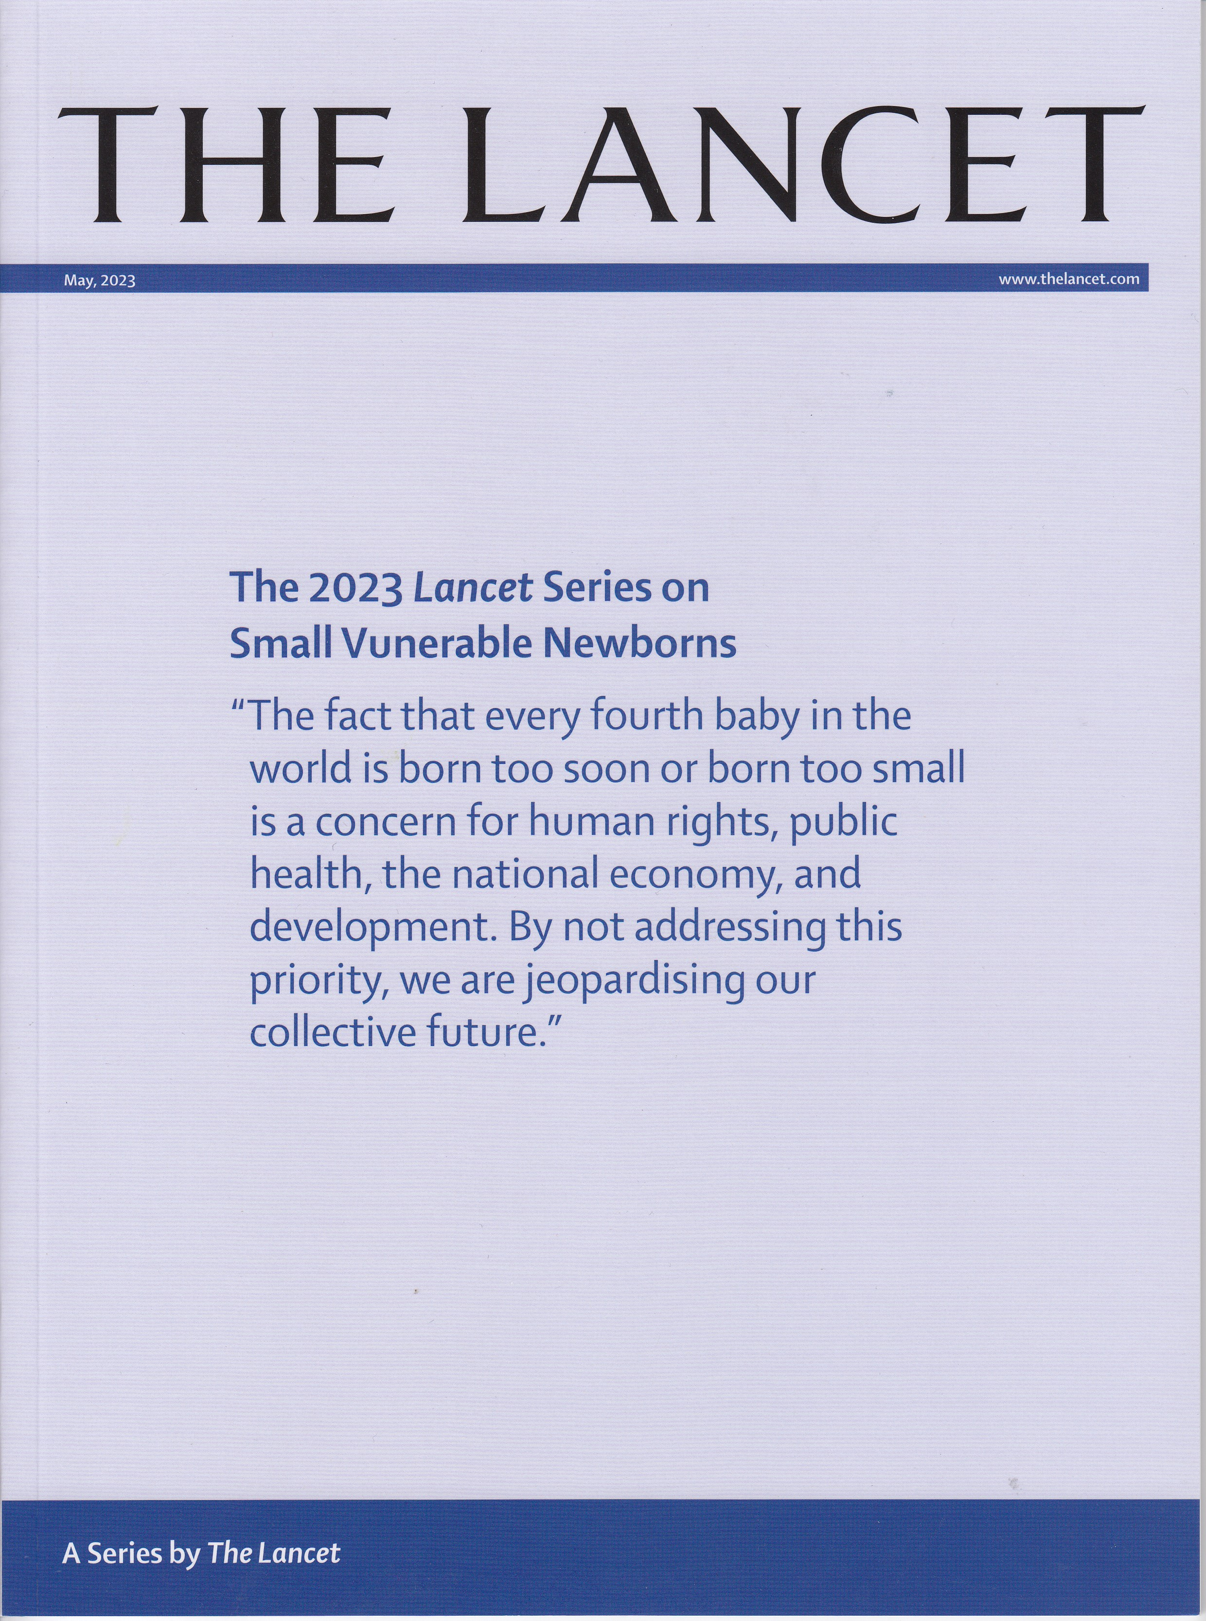
https://www.thelancet.com/series/small-vulnerable-newborns

Slide 3
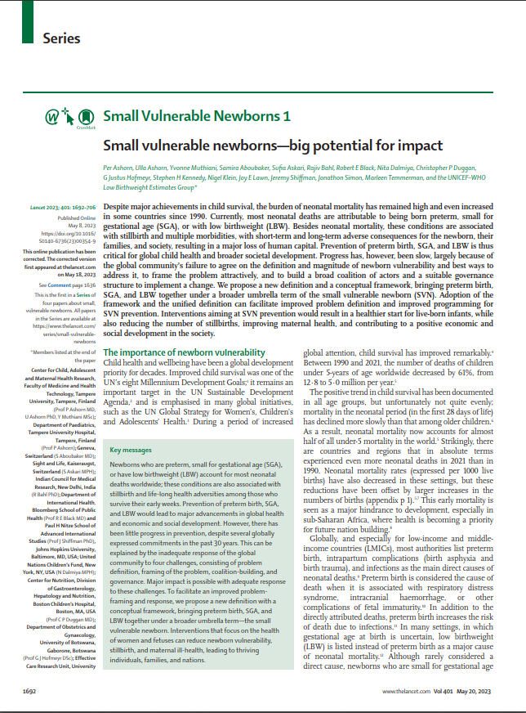
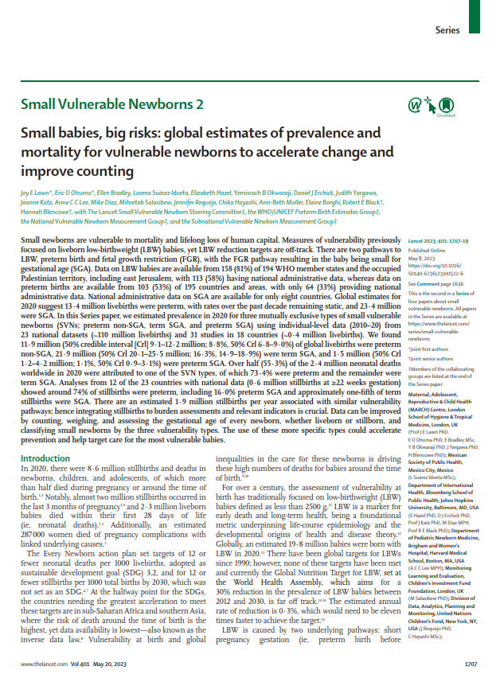
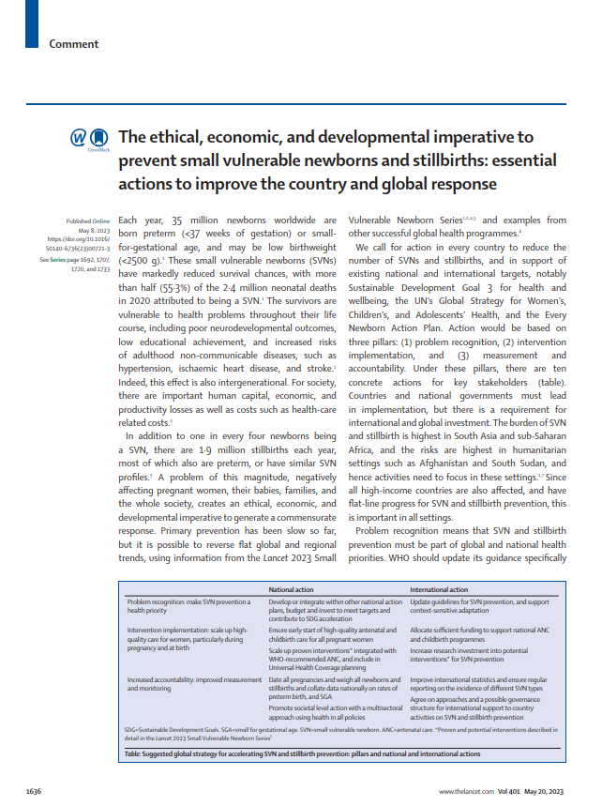
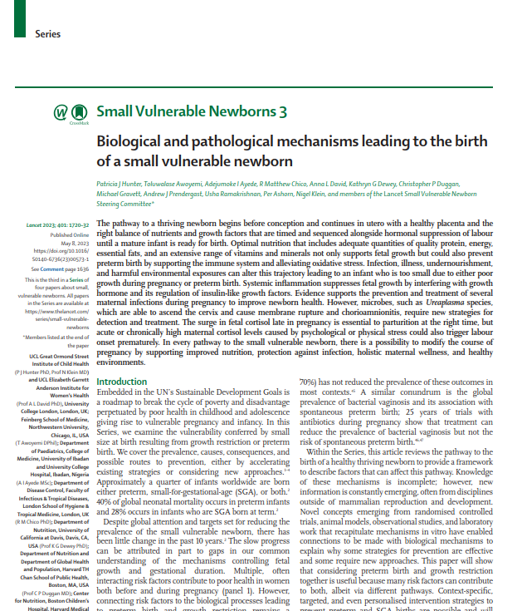
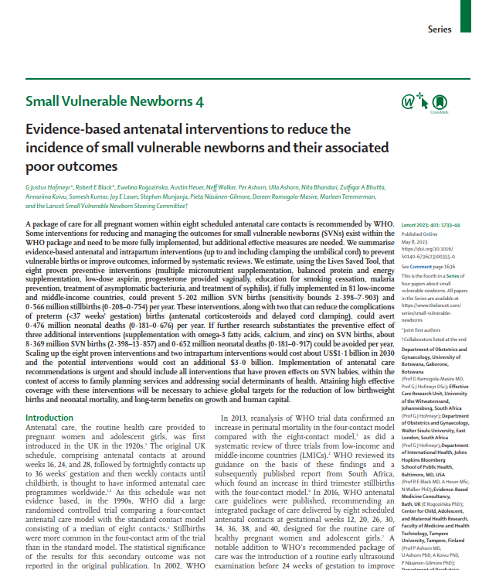

Slide 4
Small Vulnerable Newborns 1
Small vulnerable newborns—big potential for impact
Per Ashorn, Ulla Ashorn, Yvonne Muthiani, Samira Aboubaker, Sufia Askari, Rajiv Bahl, Robert E Black, Nita Dalmiya, Christopher P Duggan,
G Justus Hofmeyr, Stephen H Kennedy, Nigel Klein, Joy E Lawn, Jeremy Shiffman, Jonathon Simon, Marleen Temmerman, and the UNICEF–WHO Low Birthweight Estimates Group

Slide 5
Message: Three different constructs for defining newborn vulnerability
Low birth weight
Preterm birth
Small for gestational age
Notes:
Evolved over last century as technology and knowledge progressed, each used for varying purposes e.g. LBW epidemiology/PH reasons, preterm clinicians, SGA nutritionists. The dichotomous classification of LBW at 2500 g is not granular enough to understand the continuous gradients of risk for vulnerability.
First, the definitions convey different types of information: preterm birth and SGA indicate processes that lead to newborn vulnerability, whereas LBW indicates only small birth size, with no reference to its determinants. Importantly, the use of multiple definitions makes it difficult to establish the total burden of the small newborn problem, since each definition is incomplete.
Unite the three constructs into one
Our definition of small vulnerable newborn includes all live newborns who are preterm (born before 37 completed weeks of gestation), are small for gestational age at birth (birthweight below the 10th centile of the recommended international, sex-specific birthweight for gestational age standard), or have low birthweight (LBW;

Slide 6
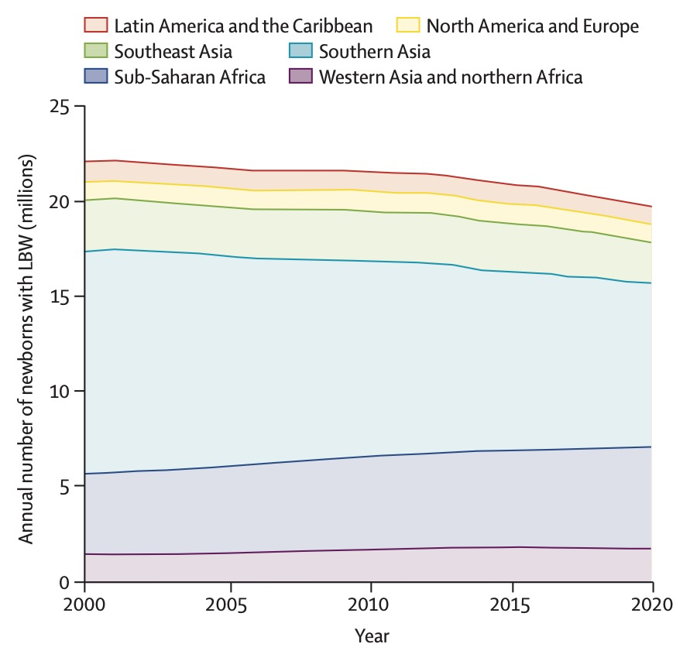
Message: Little progress in LBW prevention, despite multiple global commitments
Estimates by UNICEF and WHO for 194 WHO member states and the occupied Palestinian territory (including east Jerusalem)
Yemisrach Okwaraji, Julia Krasevec, Ellen Bradley, Joel Conkle,
Gretchen A Stevens, Giovanna Gatica-Dominguez, Eric O Ohuma,
Chris Coffey, Diana Estevez Fernandez, Hannah Blencowe, Ben Kimathi,
Ann Beth Moller, Alexandra Lewin, Laith Hussain-Alkhateeb,
Nita Dalmiya, Joy E Lawn, Elaine Borghi, Chika Hayashi
Notes:
At present, approximately 20 million infants are born with LBW each year, with little decline overall in the past 20 years. In absolute numbers, there has been a small reduction in southern Asia and an increase in sub-Saharan Africa, but these changes reflect mostly trends in the numbers of livebirths, rather than changes in LBW prevalence.
1990 World Summit for Children - reduction of the prevalence of low birthweight (LBW) to less than 10% was defined as a key nutritional goal
World Health Assembly (WHA) set the reduction of LBW prevalence by 30% between 2010 and 2030 as a global nutrition target.
WHO Born too soon
Every Newborn Action Plan

Slide 7
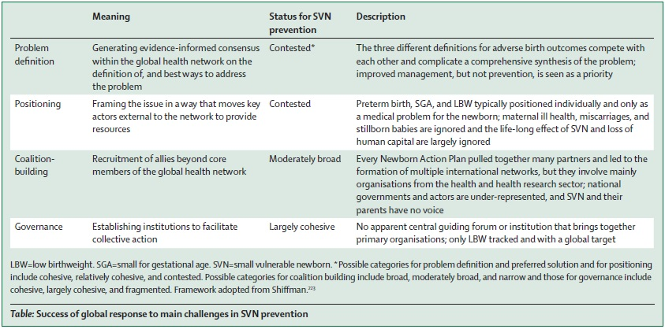
Message: Slow progress can be explained by an inadequate response of the global community to four challenges

Slide 8
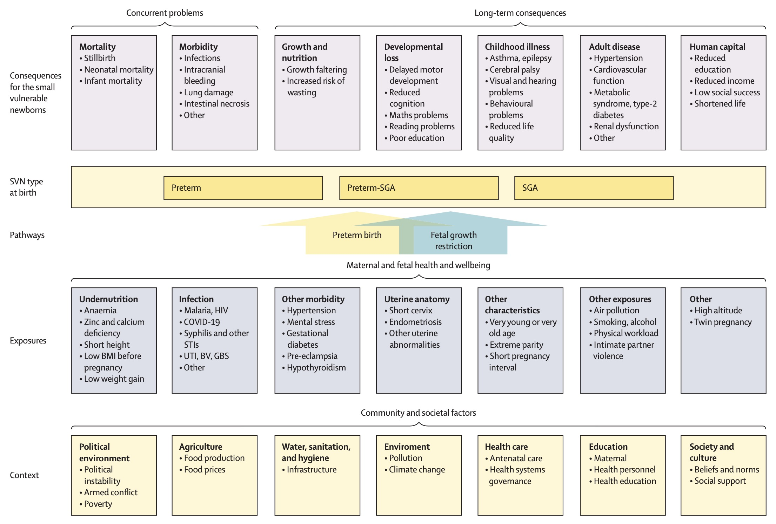
Message: New framework of Small vulnerable newborns can facilitate a better response
Adverse consequences
Small Vulnerable Newborn
Preterm birth & FGR
Adverse exposures
Contextual factors
Notes:
Conceptual framework of SVN: causes, types, and consequences
…similar to the framework that WHO used for childhood stunting, and assumes that there are contextual factors (root causes) that predispose mothers and fetuses to adverse exposures (immediate causes), leading to fetal growth restriction, preterm birth, or both. These two mechanistic pathways can result in three main SVN types. Under very adverse conditions, the same pathways can lead to fetal death (ie, a miscarriage or stillbirth).

Slide 9
Message: Interventions for the health of girls, women, and fetuses, can break the vicious cycle of vulnerability

Slide 10
Small Vulnerable Newborns 4
Evidence-based antenatal interventions to reduce the incidence of small vulnerable newborns and their associated poor outcomes
G Justus Hofmeyr, Robert E Black, Ewelina Rogozińska, Austin Heuer, Neff Walker, Per Ashorn, Ulla Ashorn, Nita Bhandari, Zulfiqar A Bhutta,
Annariina Koivu, Somesh Kumar, Joy E Lawn, Stephen Munjanja, Pieta Näsänen-Gilmore, Doreen Ramogola-Masire, Marleen Temmerman,
and the Lancet Small Vulnerable Newborn Steering Committee
Notes:
WHO recommends eight scheduled antenatal contacts
This includes routine early ultrasound examination
We systematically searched for systematic reviews of interventions:
reducing preterm, SGA, or LBW births,
reducing associated poor outcomes
We used the Lives Saved Tool (LiST) to estimate the effect on health outcomes, of increased intervention coverage

Slide 11
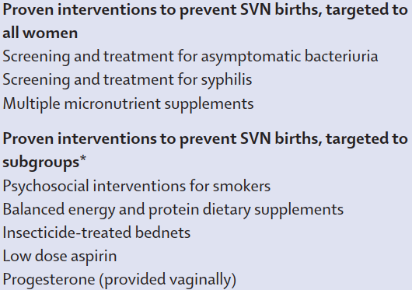
Message: There are many available preventive intervention options
Quality and access to care:
Early access to antenatal care
Routine ultrasound scan
Access to sexual/reproductive health services
Societal level action:
Women’s agency, collective action
Multi-sectoral approach using health in all policies

Slide 12
Message:
Notes:
Scaling up $1.1 billion a year
Eight low-cost and easily implementable proven interventions for pregnant women in 81 low- and middle-income countries (LMICs) could prevent an estimated 566,000 stillbirths and 5.2 million babies a year from being born preterm or small for gestational age—some with low birth weight—the impacts of which would also affect long-term health and economic output, says a new four-paper Series published in The Lancet.

Slide 13
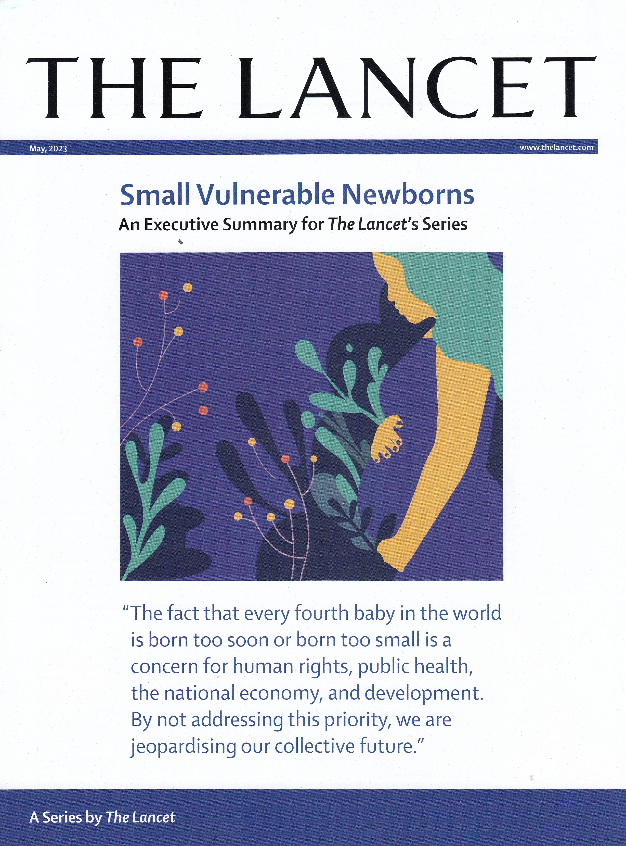
Key messages on SVN
Very common, 26% of newborns (35 million)
Highest in: Southern Asia and Sub-saharan Africa
Accounts for 1.4 million neonatal deaths and 1.9 million stillbirths annually, and a lot of child and adult morbidity
Increases health care costs and causes losses in equity, human capital, development & economy
No progress in prevention, despite several global commitments
15-20% of SVN and its consequences preventable with existing, low-cost interventions
Better results likely with multipronged interventions

