Slide 1
Notes:
Objective: launch the Series in this region and gather you all – important stakeholders – together to generate discussion, debate and agree on a roadmap to tackle SVNs in our region – concrete actions!

Slide 2
The ethical, economic, and developmental imperative to prevent small vulnerable newborns and stillbirths: essential actions to improve the country and global response.
Abdu Mohiddin, Katherine E A Semrau, Jonathon Simon, Etienne V Langlois, Jeremy Shiffman, Helen Nabwera, G Justus Hofmeyr, Joy E Lawn, Robert E Black, Sufia Askari, Nigel Klein, Ulla Ashorn, Per Ashorn, Marleen Temmerman

Slide 3
Large numbers and slow prevention
Global annual estimates of any SVN type:
35 million SVNs worldwide
One in four newborns
1·9 million stillbirths each year
Sub-Saharan Africa, South Asia, humanitarian settings
Prevention has been slow
Flat global and regional trends
Notes:
~26% of all newborns are SVN
-55% of neonatal mortality attributed to SVN
Larger than expected, inequalities
Failure of global response to main challenges in SVN prevention
Mortality in the neonatal period (in the first 28 days of life) has declined more slowly than that among older children
In a recent dataset51 including more than 18 million births from Brazil between 2011 and 2018, the prevalence of preterm birth was 9·4%, SGA 9·2%, and LBW 9·6%. However, 18·0% of the newborns were included in at least one of the categories, indicating that the use of any one of the individual definitions would underestimate the number of all at-risk newborns by approximately 50%.
K’Oloo et al_LBW measurement intervention 2023_(provision of high-quality digital scales, training of nursing staff on accurate birth weight measurement, recording and scale calibration practices, and quality maintenance support that consisted of enhanced supervision and feedback): In the prospective sample, the prevalence of LBW was 12.6% (95% confidence intervals [CI]: 10.9%-14.4%) in Kenya and 18.2% (12.2%-24.2%) in Tanzania. In the historical sample, the corresponding prevalence estimates were 7.8% (6.5%-9.2%) and 10.0% (8.6%-11.4%). Compared to the retrospective sample, the LBW prevalence in the prospective sample was 4.8% points (3.2%-6.4%) higher in Kenya and 8.2% points (2.3%-14.0%) higher in Tanzania, corresponding to a risk ratio of 1.61 (1.38-1.88) in Kenya and 1.81 (1.30-2.52) in Tanzania.

Slide 4
Action based on three pillars
Pillar One:
Make SVN prevention a priority
Pillar Two:
Intervention implementation & scale-up
Pillar Three:
Measurement and accountability
Notes:
Pillar 2: Scale up high quality care for women during pregnancy and child birth
Pillar 3: Improved measurement and monitoring

Slide 5
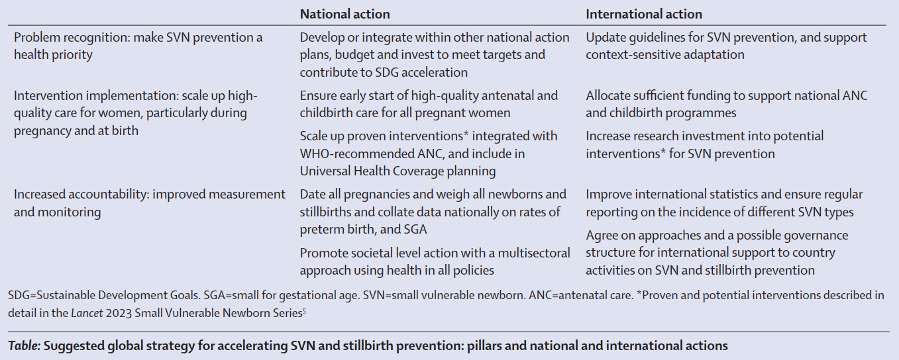
Suggested global strategy for accelerating SVN and stillbirth prevention

Slide 6
Pillar One
Problem recognition: make SVN prevention a (health) priority
International action
Update guidelines for SVN prevention, and support context sensitive adaptation
National action
Develop or integrate SVN prevention within relevant national action plans, budget and invest to meet targets and contribute to Sustainable Development Goals acceleration

Slide 7
Pillar Two
Intervention implementation: scale up high-quality care for women, particularly during pregnancy and childbirth
International action
Allocate sufficient funding to support national ANC and childbirth programmes
Increase research investment into potential interventions for SVN prevention
National action
Ensure early start of high-quality antenatal and childbirth care for all pregnant women
Scale up proven interventions integrated within WHO recommended ANC guidelines, and include in Universal Health Coverage planning

Slide 8
Pillar Three
Increased accountability: improved measurement and monitoring
International action
Improve international statistics and ensure regular reporting on the incidence of different SVN types
Agree on approaches and a possible governance structure for international support to country activities on SVN and stillbirth prevention
National action
Date all pregnancies and weigh all newborns and stillbirths and collate data nationally on rates of preterm birth, SGA and LBW
Promote societal level action with a multi-sectoral approach using health in all policies, women’s agency and reproductive rights are enhanced

Slide 9
Recommended national actions
Develop or integrate SVN prevention within relevant national action plans, budget and invest to meet targets and contribute to Sustainable Development Goals acceleration
Ensure early start of high-quality antenatal and childbirth care for all pregnant women
Scale up proven interventions integrated within WHO recommended ANC guidelines, and include in Universal Health Coverage planning
Date all pregnancies and weigh all newborns and stillbirths and collate data nationally on rates of preterm birth, SGA and LBW
Promote societal level action with a multi-sectoral approach using health in all policies, women’s agency and reproductive rights are enhanced

