Slide 1



Measurement Past, Present, and Future for Small Vulnerable Newborns, Born Too Soon and Too Small
Eric Ohuma, BSc MSc DPhil CStat
Associate Professor
London School of Hygiene & Tropical Medicine
@Ohumaeric
#VulnerableNewborns
#EveryNewborn
#EndStillbirths
#imnhc2023

Slide 2


Huge Teams involved
>250 national and study team collaborators with thanks to all women and families included in these datasets which include >165 million livebirths
WHO and UNICEF preterm and LBW estimates groups, regional and country offices, members of the Expert Consultative Group
LSHTM and JHU teams who facilitated these collaborations
CIFF for funding
Word cloud of co-authors´ names

Slide 3

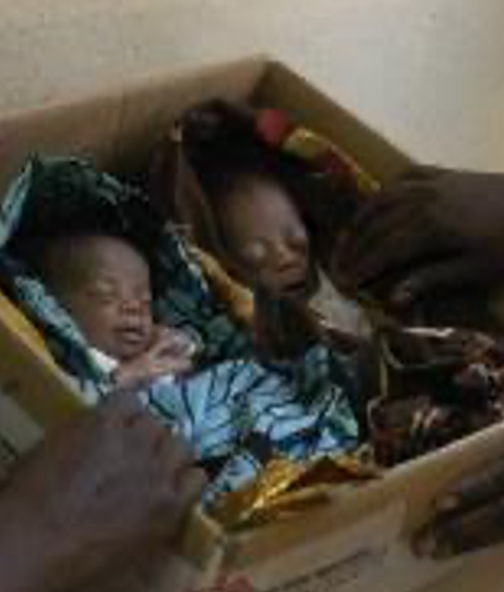
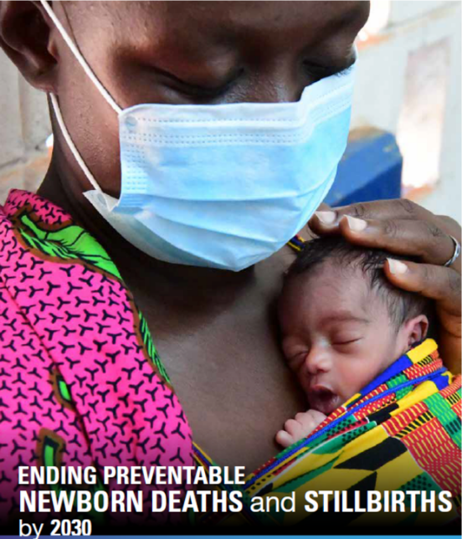
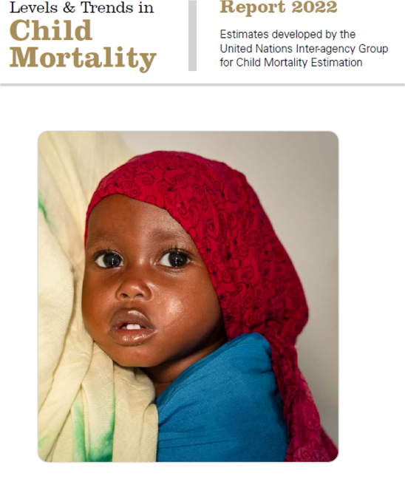

SUSTAINABLE DEVELOPMENT GOALS AT HALF TIME…
>8 million deaths of children per year
1.9 Million Stillbirths
2.3 Million Neonatal Deaths
4.0 Million Child Deaths
(1 month – 20 years)
> 50% related to birth
Majority are LBW and/or preterm
STUNTING and LIFECOURSE effects are a driver of child mortality, thriving, human capital

Slide 4

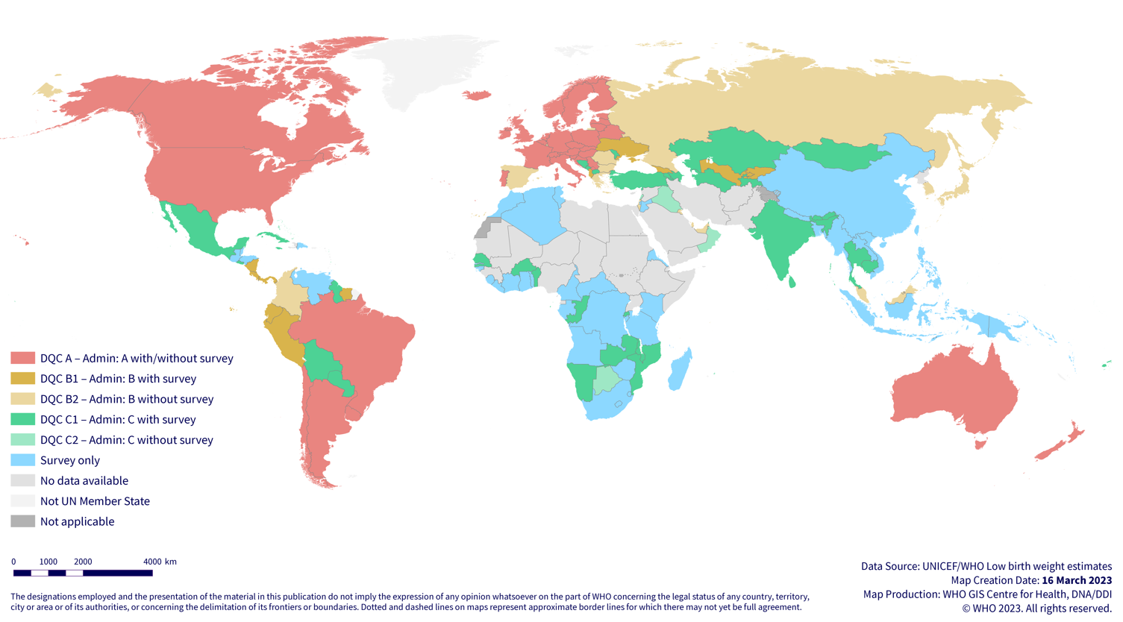
Data Gaps and Multiple Data Sources: LBW
Survey data only
No data available

Slide 5




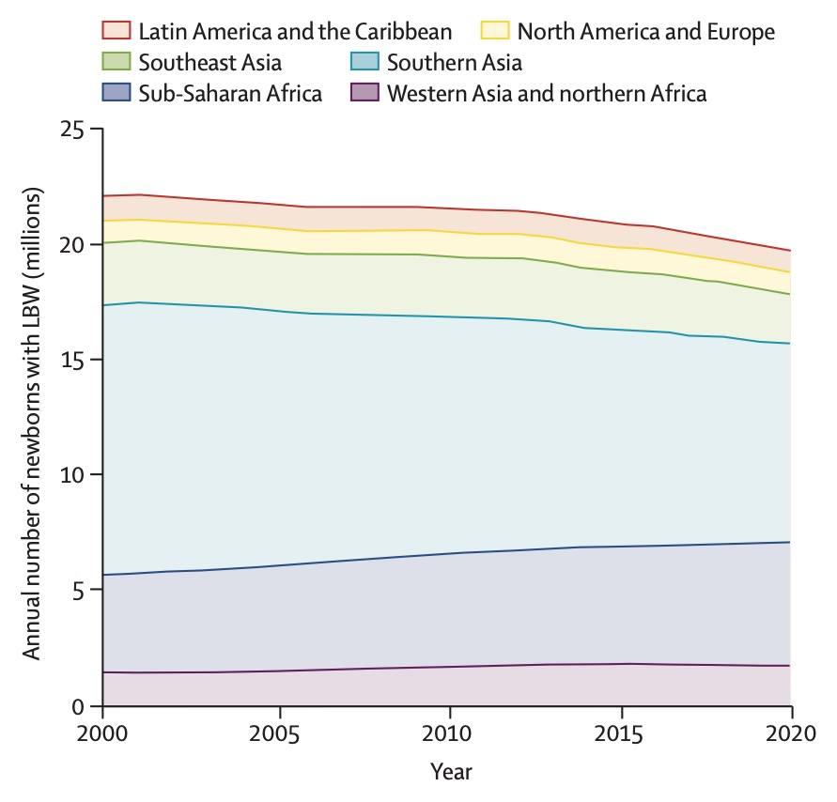

WHERE WE ARE: Low birthweight
Data (2000-2020)
113 countries (58%) routine national data
95 countries survey data
Current Estimates
Numbers: 19.8M were born LBW in 2020 (14.7%)
Variation: National LBW birth rates vary from under 5% to >20%
Trends: No change in global LBW birth rate in the last two decades
References: Lancet SVN, 2023 - Ashorn et al; UNICEF WHO estimates

Slide 6
WHERE WE ARE: Low birthweight
Sub-Saharan Africa
2000: 15.7% (4.23 million)
2010: 14.7% (4.90 million)
2020: 13.9% (5.38 million)
In Kenya
2000: 11.7% (144,343)
2010: 10.9% (159,913)
2015: 10.6% (153,403)
2020: 10.0% (145,174)
References: Lancet SVN, 2023 - Ashorn et al; UNICEF WHO estimates

Slide 7
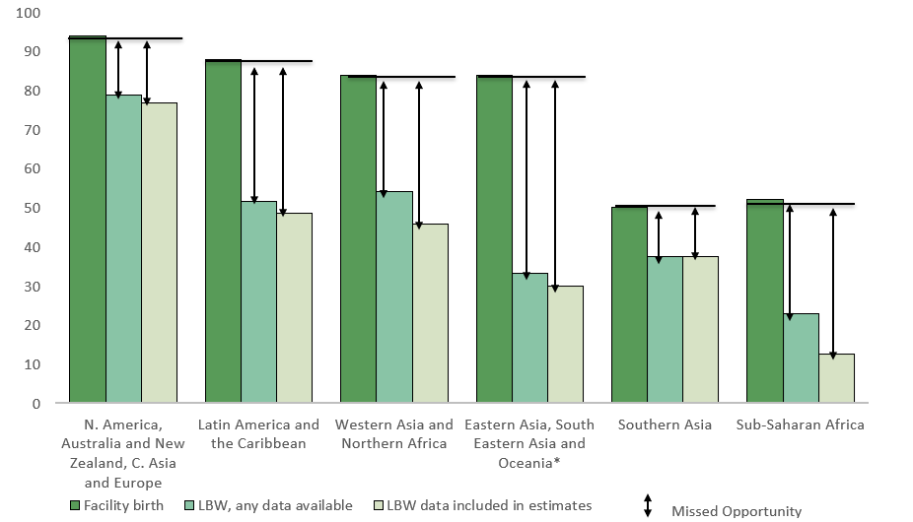
DATA: MISSED OPPORTUNITIES FOR LBW
195 countries and territories: 113 have national LBW data
BIRTHWEIGHT
References: Lancet SVN, 2023 - Lawn, Ohuma et al

Slide 8
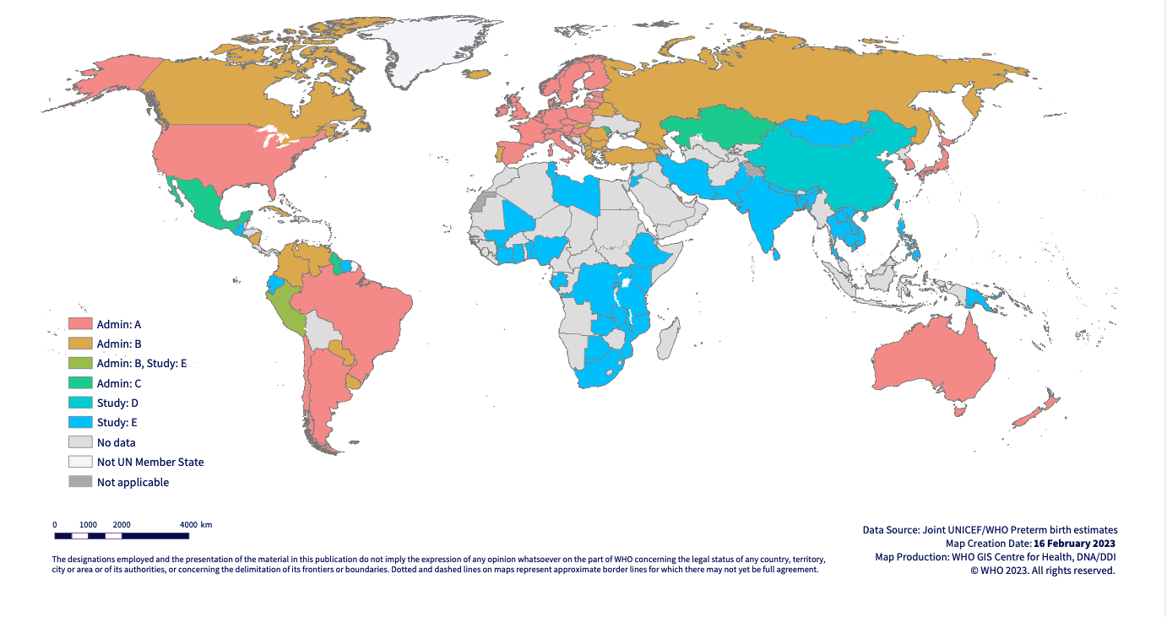
Data Gaps and Multiple Data Sources: Preterm
Data from subnational studies and rated lowest quality category
No data available
References: Lancet SVN, 2023 - Lawn, Ohuma et al; UNICEF WHO estimates

Slide 9
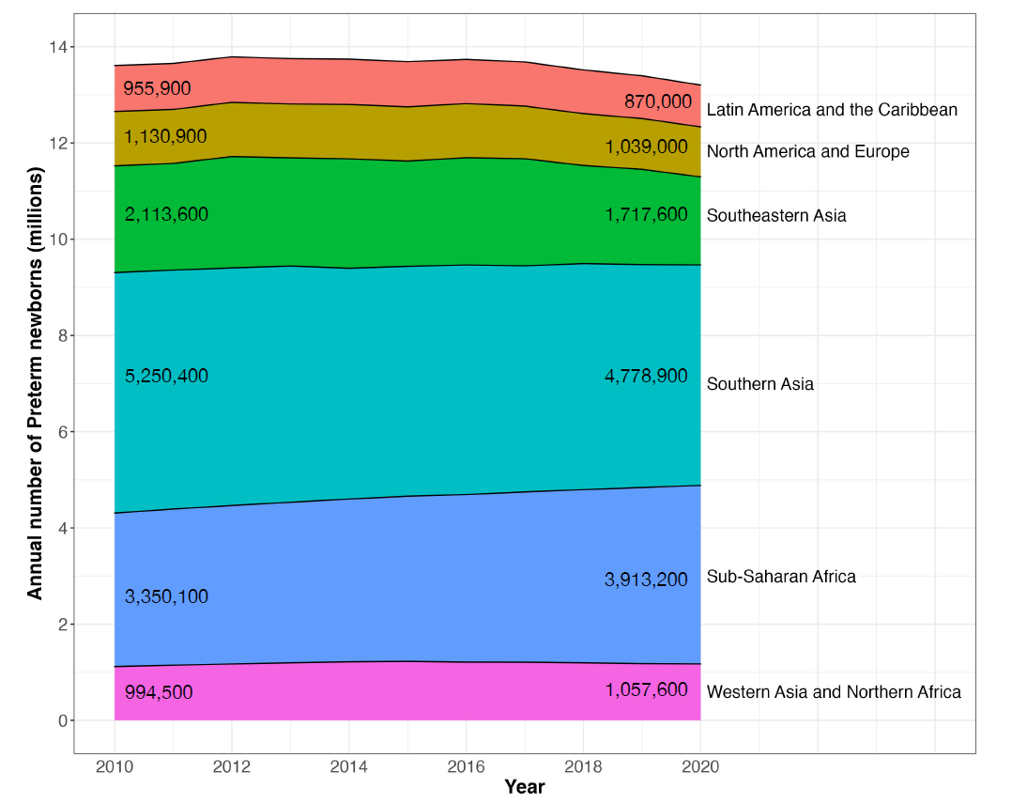
WHERE WE ARE: Preterm
Data (2010-2020)
64 countries and territories (33%) have routine national preterm data
40 countries and territories have study data
Current Estimates
Numbers: 13.4M were born preterm in 2020 (9.9%) - 1 in 10 newborns were BORN TOO SOON
Variation: National preterm birth rates vary from under 5% to >15%
Trends: No change in preterm birth rates for any region in the last decade
References: Lancet SVN, 2023 - Lawn, Ohuma et al; UNICEF WHO estimates

Slide 10
WHERE WE ARE: Preterm
Sub-Saharan Africa
2010: 10.1% (3.35 million)
2020: 10.1% (3.91 million)
In Kenya
2010: 8.8% (128,780)
2020: 8.8% (127,500)
References: Lancet SVN, 2023 - Lawn, Ohuma et al; UNICEF WHO estimates

Slide 11
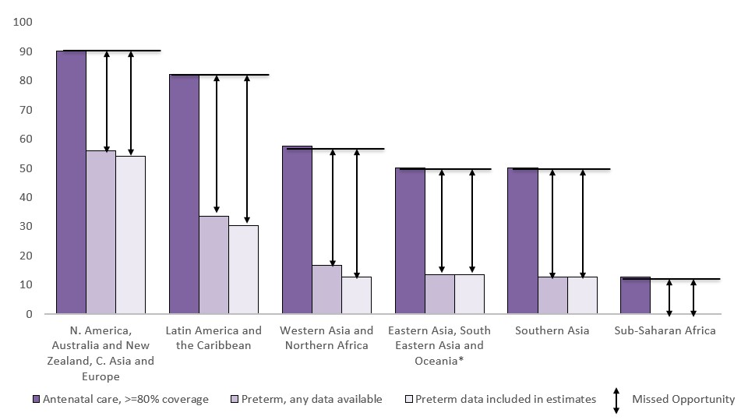
DATA: MISSED OPPORTUNITIES FOR PRETERM
195 countries and territories: 64 have national preterm data
GESTATIONAL AGE
References: Lancet SVN, 2023 - Lawn, Ohuma et al

Slide 12
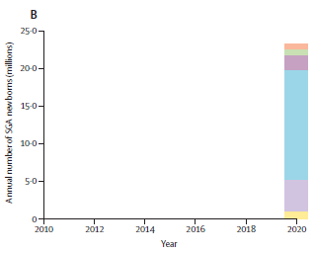
WHERE WE ARE: Small for Gestational Age (SGA)
Data (2020)
Only 8 countries and territories (0.04%) have national SGA data
Current Estimates
Numbers: 23.4M were born SGA in 2020 (17.4%) - 1 in 5 newborns were BORN TOO SMALL
Variation: Nearly two thirds (63%) of the world’s SGA newborns were born in Southern Asia
Trend: No trend data/estimates
References: Lancet SVN, 2023 - Lawn, Ohuma et al

Slide 13
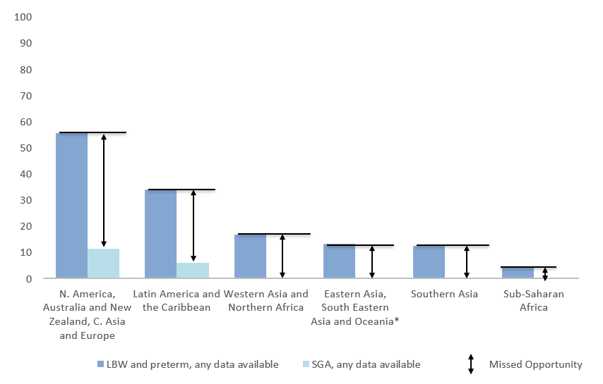
DATA: MISSED OPPORTUNITIES FOR SGA
195 countries and territories: Only 8 have national SGA data
BIRTHWEIGHT AND GESTATIONAL AGE
References: Lancet SVN, 2023 - Lawn, Ohuma et al

Slide 14
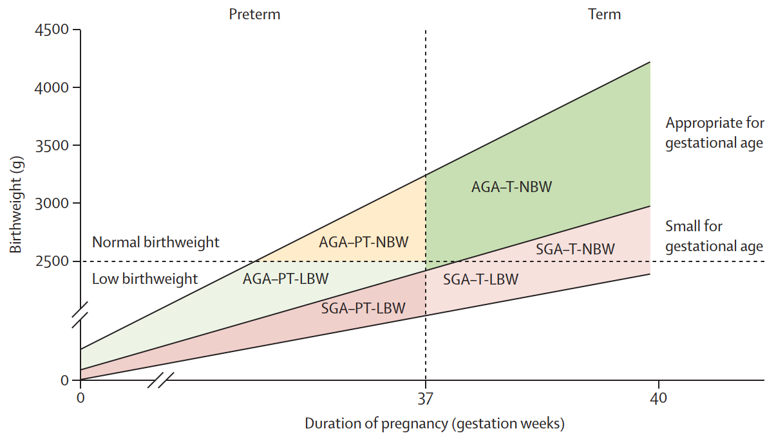
Vulnerable newborn types – shifting the paradigm
Input data required (individually linked)
Birth outcome
Sex
Birthweight
Gestational age
Input data call and searches in 2020
Three distinct small vulnerable newborn types
Preterm non SGA Term SGA Preterm SGA
(“Born too soon”) (“Born too small”) (“Too soon and too small”)

Slide 15
Estimated distribution of small newborn types worldwide for 2020
Message 1: Small babies, big numbers
Preterm + SGA
35.3 million (26.2%) newborns in 2020 with any small vulnerable type
Preterm non SGA
One in four of all newborns
7.7 million (19.9%) in sub-Saharan Africa in 2020 with any small vulnerable type

Slide 16
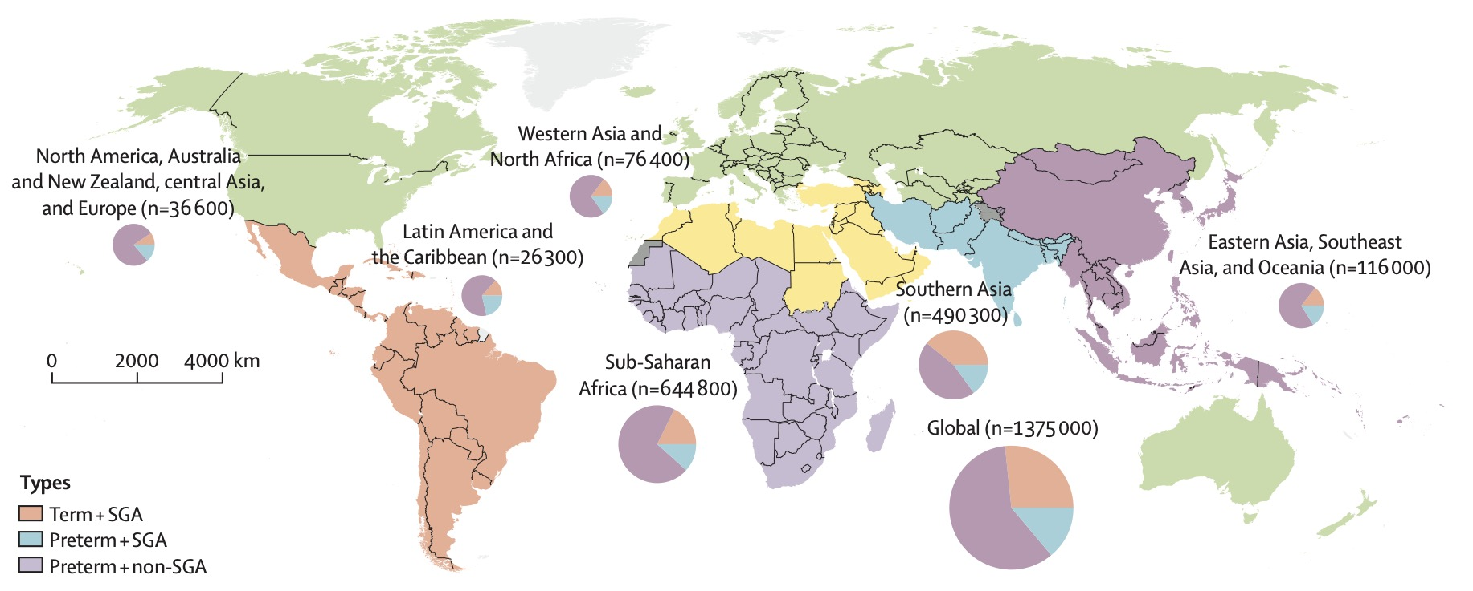
Message 2: Big mortality risk …..around the world
80% of the 1.4 million neonatal deaths attributable to SVN types
are in Southern Asia and sub Saharan Africa
#SmallVulnerableNewborns

Slide 17

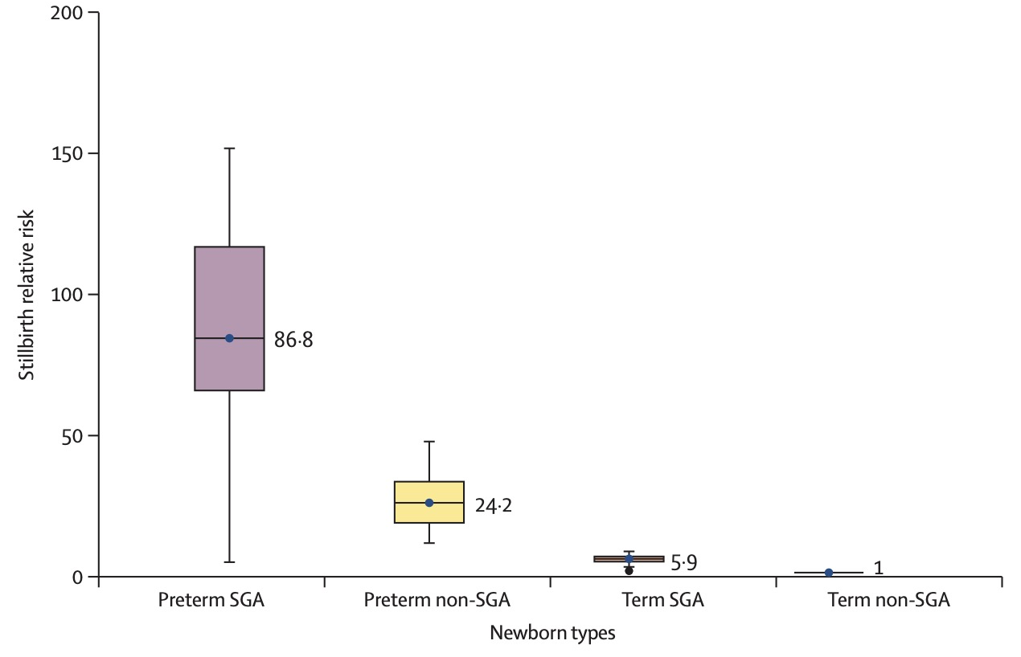
Stillbirths are more likely to be preterm and small
Data inputs
12 countries with national data
N = 605557 stillbirths after 22 weeks
Findings
75% of stillbirths born preterm
~20% of term stillbirths were SGA
Most preterm at the most risk, and highest if preterm and SGA
Including stillbirths in relevant indicators and burden assessments is rational to better inform decision making, research and respect the impact on families

Slide 18
Counting every newborn… improving and using the data
Data status
194 Countries and areas with national data
113 for LBW estimates
64 for preterm estimates
8 for SGA
Every pregnant woman able to access ultrasound
Every baby weighed + counted (including stillbirths)
Small vulnerable newborn types classified
Individual-level data collected and used for action
Opportunities
~90% antenatal coverage
increase accurate gestational age measurement
increase use of recent GA measurement innovations
>80% of births are now in facilities
increase accurate birth weight measurement
Investments in national routine data systems

Slide 19


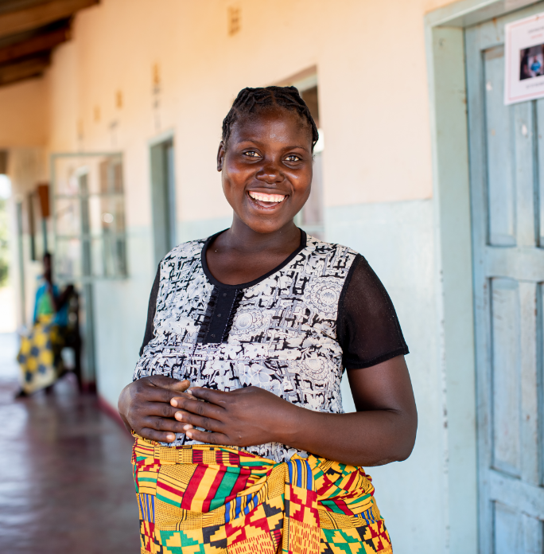

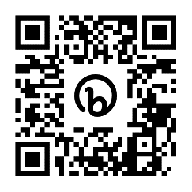
OUTPUTS SO FAR
Coming soon – Lancet in press
Preterm Birth & Low Birthweight estimates
The Lancet series on small vulnerable newborns
BJOG: Vulnerable newborn series
Born Too Soon report
https://bit.ly/lancetsvn
BJOG papers
https://bit.ly/bjog_vn
www.borntoosoonaction.org

